Slide 1

29th September 2023
9:00-9:30 Arrival & networking
9:30-09:40 Introduction & Updates
9:40-10:00 New Talk Wellbeing Service
10:00 -11:00 Developing a Carers Strategy
11:00-11:30 Refreshments & Networking
Switch over to Community Paradigm Workshop Event …
24th March 2022

Slide 2

Christine Prince
Chief Officer – Healthwatch Herefordshire
Introduction & Updates
24th March 2022

Slide 3
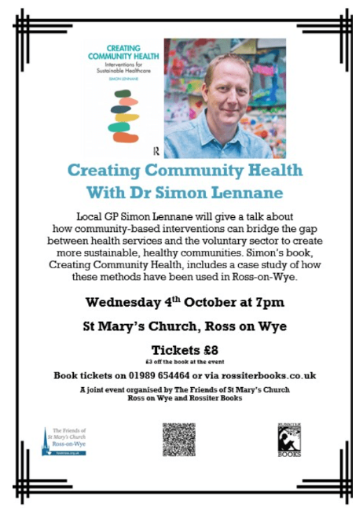


If you have a community group or event over the autumn, where we could come along and hear from people about their caring role, please contact Sam.
Sam@healthwatchherefordshire.co.uk
01432 277044
24th March 2022

Slide 4



24th March 2022
hvoss Eventbrite link

Slide 5
NHS Herefordshire and Worcestershire ICB Engagement – Have your say!
How to have your say and share your views:
Survey – Please tell us your views by using the survey link: https://www.surveymonkey.co.uk/r/ICBEngagement
Email - If you would like to email us, please do on hw.engage@nhs.net
Telephone – You can call 0330 053 4356 and ask for the engagement team.
If you would like this information in another language or format please contact hw.engage@nhs.net or call 0330 053 4356 and ask for the engagement team.
Deadline – Please complete the survey or share your views by 9am, Friday 13 October 2023.
www.hwics.org.uk
24th March 2022

Slide 6

Gillian Pearson
Associate Primary Care Network Director of Prevention, Partnerships & Transformation
Talk Wellbeing Service
24th March 2022

Slide 7


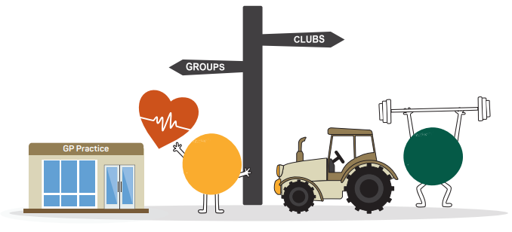

Talk Wellbeing
Community Partnership Update September 2023

Slide 8

Purpose
Bringing together a range of prevention pathways to support a more effective and accessible approach to providing healthcare interventions to our underserved communities, delivering a positive patient experience.
Target populations
• Unregistered populations
• Seasonal and Farming communities
• Those living in areas of high deprivation
• Those for whom English is not their first language
• Hesitant populations
• Migrant communities
• Rural communities
• Digitally excluded

Slide 9
The Service
Health check plus (ish)!
Similar to NHS Health checks, but with reduced exclusion criteria
Anyone 18+ years
Detection of atrial fibrillation
Blood pressure checks
Cholesterol checks
Generic health and wellbeing screening for our unregistered population
Awareness and education across communities around health risks of CVD, AF, hypertension, smoking, obesity
Support people to register at a practice
Signposting – social prescribing
Covid vaccinations (in line with seasonal vaccination programme)
Delivered by health care assistants and social prescribers
Outreach approach, either in community settings or using the outreach bus

Slide 10
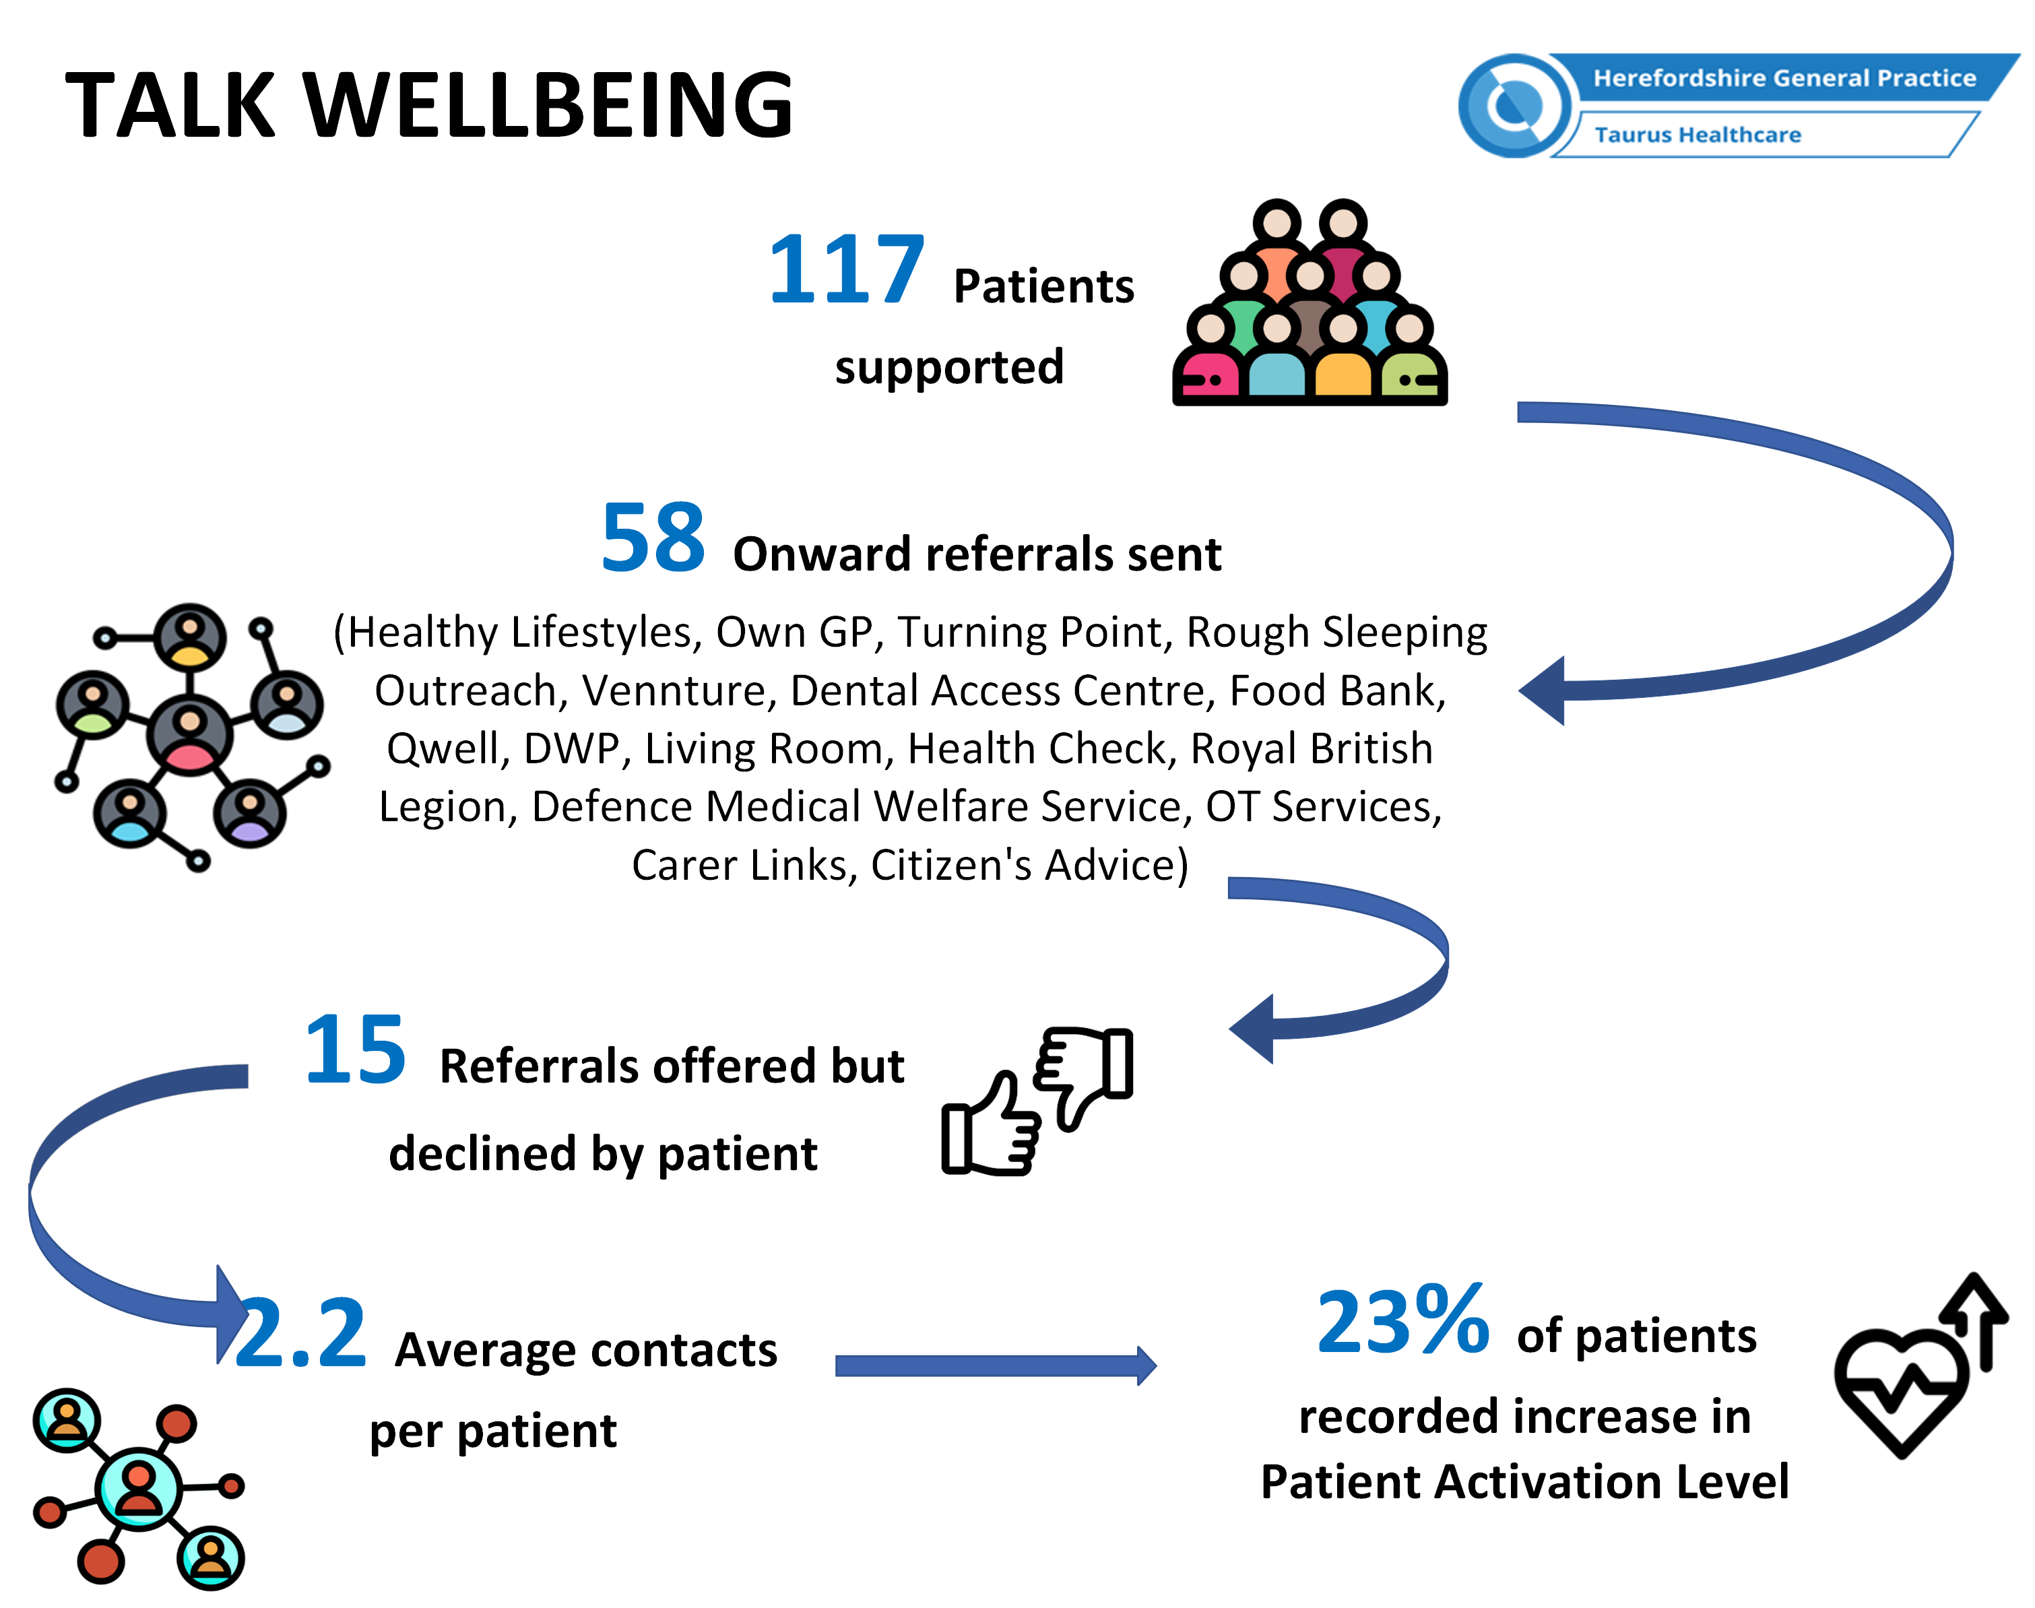
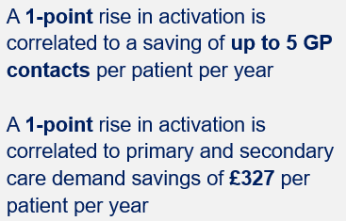
Impact
(17.07.23-26.09.23)
Approximate savings to primary & secondary care = £14,388
Saving up to 200 GP contacts a year
Source: NAPC

Slide 11
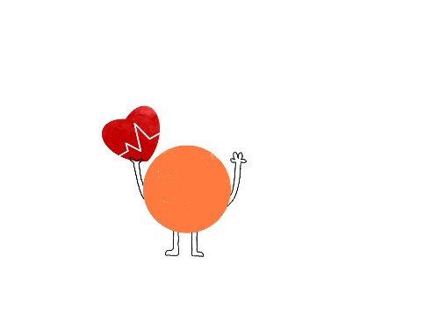

Outcomes (total appointments: 202)
(17.07.23-13.09.23)
3 patients have been registered at a GP Practice through Talk Wellbeing
20 patients with moderate/high QRisk status
22 patients with a high blood pressure
24 patients with high cholesterol
138 contacts with a social prescriber
117 health checks completed
Key themes of contacts
Homelessness
Access to food
Advice on housing
Signposting to Benefit support and reviews
Too busy to go to practice

Slide 12


Events – October
Location | Month & Frequency | Target Cohort
Hereford Livestock Market | Thurs 5th Store Cattle Sale Tue 24th Breeding Ewes & Weaned Calves Sale | Agricultural population, rurally and digitally excluded
Tesco Belmont | October – Alternate Friday's weekly | High deprivation area, low income and health. Where English is service users second language.
Cart Shed | Date T.B.C | Cohorts with learning difficulties and mental health issues as well as low income. Rurally and digitally excluded
Asda | October- Alternate Friday's weekly | Area of income deprivation and health inequalities. Where English is service users second language.
Ross community garden | October- Wednesday weekly | Disengaged patients with healthcare, deprivation of income and mental health issues
Healthy lifestyle team | Working with the team to jointly attend events where appropriate
The Living Room Hereford | Ever other Monday | Disengaged patients with healthcare, deprivation of income and mental health issues
Morrisons | 21st October TBC | Focus on detection of atrial fibrillation

Slide 13
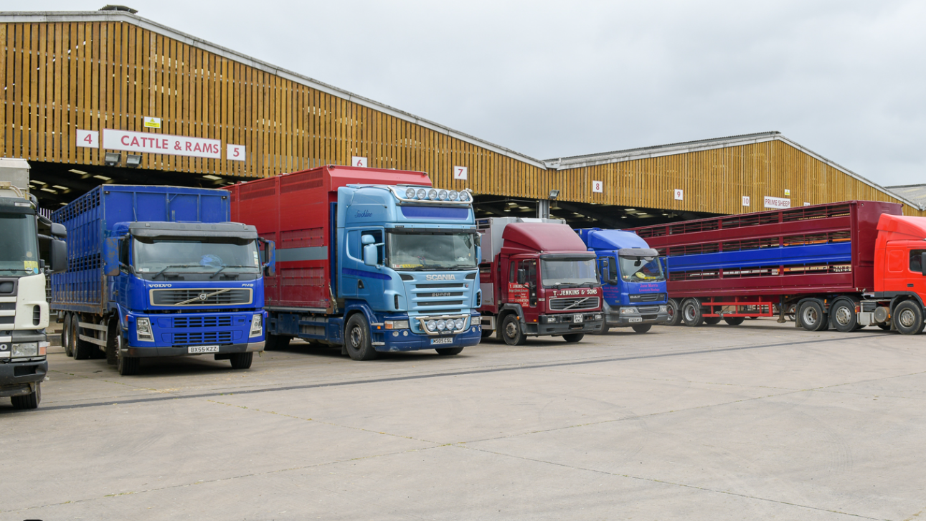
Hereford Livestock Market, Hereford 12 September
Outreach vehicle
19 Patients assessed by staff, 2 of which had urgent referrals and were seen later that day by GP. One in own surgery and one seen in enhanced access.
Positive engagement with NFU Hereford and Herefordshire rural Hub representatives to collaborate at future events
Future sales earmarked for return visit. Different days attract different farmers.
Feedback
Wish our Health service would do something like this, what a great idea
My Blood Pressure won't be good, I'm about to pay for a pen of ewes
This is really exciting it was on the TV last month and you’re here this month
What are you offering? I've not seen my GP for over 15 years
Fantastic service, are you here all day? I'll text my mother

Slide 14

The Living Room, Hereford City Centre
The Living Room is a café, a community larder and a safe community space
Everyone is welcomed and those who are homeless are offered food, drinks, clothing and support
Open during the week to support the local community
Let's Talk Wellbeing have offered health checks & Social Prescribing to the homeless and most vulnerable in the community

Slide 15
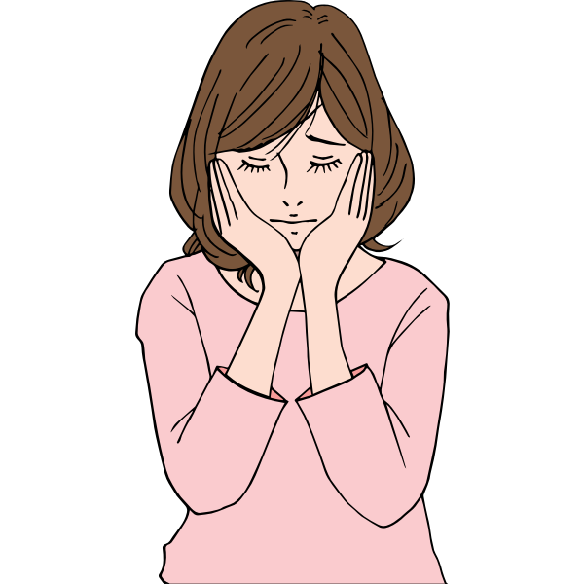





Talk Wellbeing Case Study
Background…
Patient attended appointment – persistent cough for over 8 weeks & struggling with bereavement
Support
Referral to own GP Practice for chest health check.
Referral made to St Michael’s Hospice for counselling.
Referral to Hope Support for bereavement support for children.
Issues
Persistent cough – known smoker
Recent bereavement of close relative
Patient wanting to give up smoking but not knowing where to start
Outcome
Pt had number of clinical assessments completed by their own GP.
Noted 3 yearly screening overdue - completed
Pt in engaging in counselling for herself & has been in contact with Hope Support for her children
Very helpful and caring, very pleased..

Slide 16

Talk Wellbeing Case Study
Background…
Patient feeling lonely and isolated. Low self-esteem & little sense of community or wellbeing
Support
Signposted to HVOSS for local volunteering opportunities
Signposted to Make It Happen – local creative textile shop who run workshops
Signposted to Safe Haven at MIND for creative workshops and group work
Supported to write down “What Matter to Me” in preparation for GP appointment
Issues
Patient feeling low in mood and medical issues in the forefront of mind
Lacking in sense of belonging and feeling ‘part of something’
Would like to focus less on self and more on others
Outcome
Patient feeling more positive and beginning to a sense of community and belonging
Outlets identified for creative work which involve engagement with others
Patient less focussed on medical issues and more focussed on creative outlets
To be able to be with people makes such a difference to my life…

Slide 17
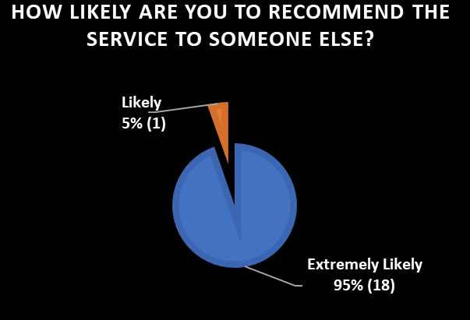

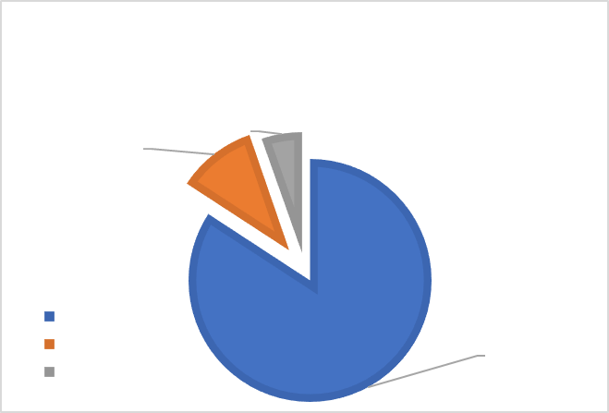
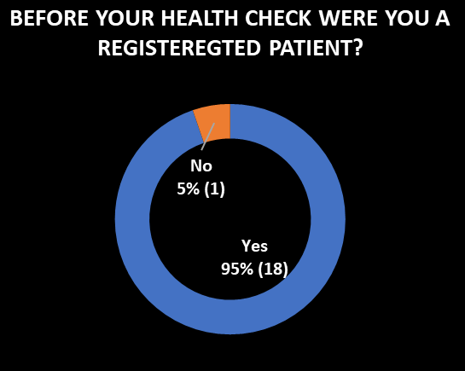
Patient Feedback
Any other comments of your experience today?
Patient comments:
Highly appreciate the understanding and caring support from Jane. I feel blessed to have worked with someone so competent and professional"
"Very helpful and caring very pleased"
"Jane was brilliant the only person who has helped"
"Helpful and not judgemental"
"Wonderful and easy. I find it difficult to talk to anyone but liked talking to Jane"
"Jane is a kind person"
"Jane was very helpful and supportive"
"Very impressed, wasn't aware of the service"
"This is very good"
"My family will be so happy that I've had an MOT"
"What a wonderful service"
Other comments:
"Phenomenal"

Slide 18
Want to know more about how we can work together to reduce people’s risk of heart disease and stroke?
We can offer drop in sessions at community groups, events or using our outreach vehicle.
If you work with people who you think will benefit from our service then you can contact us by completing the form on our website
Health and Wellbeing Services (herefordshiregeneralpractice.co.uk)
For other queries, the team can be emailed at Talkwellbeing.HGP@nhs.net

Slide 19
Jon Burgess
Senior Commissioning Officer – Community Wellbeing Directorate
Herefordshire Council
Carers Strategy Workshop
24th March 2022

Slide 20
Herefordshire Carers Strategy
September 2023

Slide 21
Unpaid carers
A carer is anyone who cares, unpaid, for a friend or family member who due to illness, disability, a mental health problem or an addiction cannot cope without their support.
Caring for someone can take up a few hours each week, a full time role.
To be a carer you do not need to live with the person you care for

Slide 22
Census 2021 – Herefordshire
Just under 1 in 10 people aged 5 and over provided unpaid care in Herefordshire – this is in line with England and Wales
The majority (9000) of unpaid carers provided 19 hours or less of unpaid care
Around 3000 unpaid carers provided between 20 and 49 hours
5000 provided over 50 hours per week.

Slide 23
£119
Billion
2011 ‘replacement care’ cost of £19.20 per hour

Slide 24
£162
Billion
2021 ‘replacement care’ cost of £22.40 per hour

Slide 25
The value of unpaid care
The figure is based on a ‘replacement care’ cost of £22.40 per hour
Unpaid care across England and Wales now worth the equivalent as NHS in England
This figure has risen 29% since 2011
The Centre for Care - https://centreforcare.ac.uk/

Slide 26
Services for carers
Herefordshire Carers Links – TuVida - Carers Links
HVOSS – support for young carers - www.hvoss.org.uk
Dementia Meeting Place / Café - Dementia Matters Here(fordshire)
Herefordshire Young Carers Club - www.hycclub.co.uk
Parent Carer Voice - https://pcvh.co.uk/

Slide 27
Previous Strategy
Joint strategy was published in 2017
A number of priority areas including
Self help and mutual support
Universal services
Valuing the skills and knowledge of carers
A new service for carers was mobilised in 2019 – Herefordshire Carers Links

Slide 28
New Herefordshire Strategy
This will be published in May 2024
Identified key themes:
Young Carers
Carers Assessments and breaks
Technology
Information and resources

Slide 29
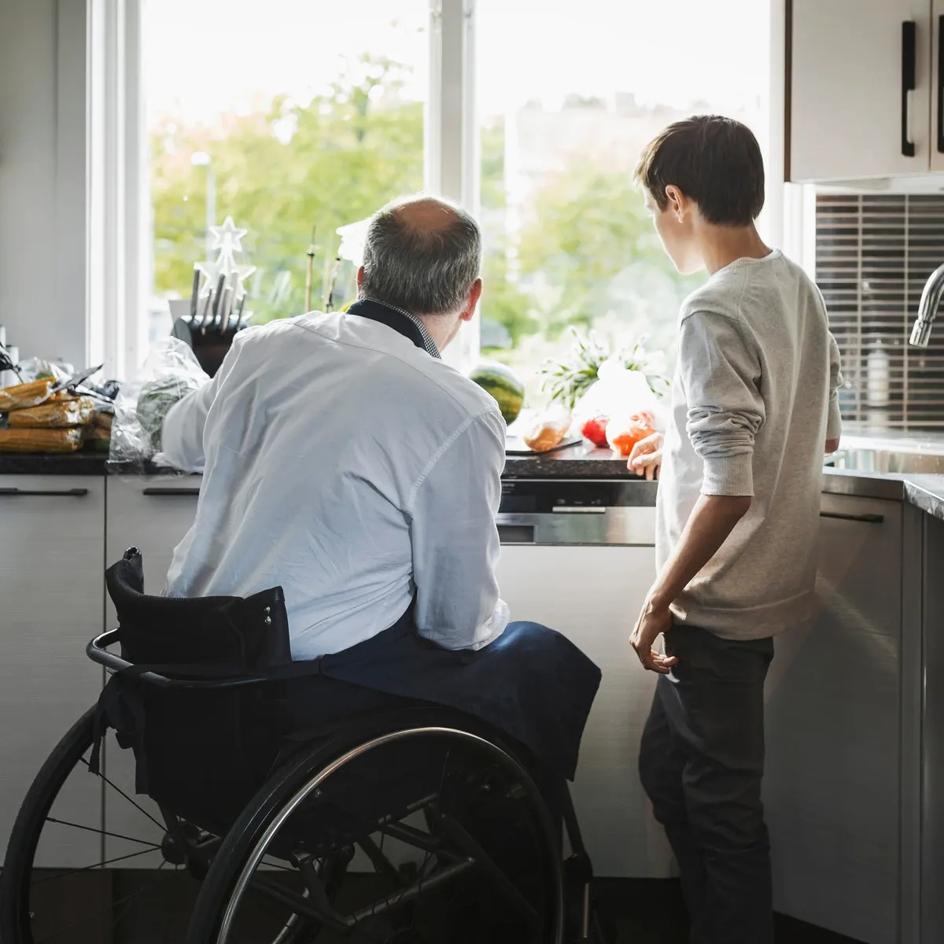
Young Carers
Can be very difficult to identify
Raising the profile
Ensuring Carers Assessments take place
Training for professionals

Slide 30

Assessments and support
The Care Act 2014 and Children and Families Act 2014
It is not always obvious that a person has a caring role
Carers support organisations provide different types of support
Need to develop Peer Support networks

Slide 31

Technology
Digital devices and equipment
Can provide information about:
Activity
Hydration and nutrition
Links to apps for carers
Offer opportunities to help carers in their role

Slide 32

Information & resources
Talk Community Hubs
Talk Community website
GP’s and social prescribers
Peer support networks
Carers Partnership Board

Slide 33

Group exercise

Slide 34
Young Carers
Thinking about Young Carers (5 to 18 years old)
What challenges might they face?
How can services (school, GP, social care etc.) improve how they identify and support a young carer?
How can we raise the profile of young carers?

Slide 35
Assessments and support
What types of support do you feel could be available for unpaid carers?
Should the council consider using a carers support service to undertake carers assessments?
How can services ( GP, hospital social care etc.) improve how they identify and support unpaid carers?

Slide 36
Information and resources
What challenges might there be to ensuring everybody has access to up to date and useful information
Are there ways in which information could be improved or be more focussed?
How can we ensure that resources and information are can be available in rural areas of Herefordshire?

Slide 37
Ideas and suggestions
Is there more that could be done to raise the profile of this important role?
Can you suggest ways in which unpaid carers could be offered more support?
How can employers be encouraged to identify and support employees who have caring responsibilities

Slide 38


Slide 39
References
Valuing_Carers_WEB2.pdf (centreforcare.ac.uk)
commitment-to-carers-may14.pdf (england.nhs.uk)
Herefordshire Carers Strategy – Herefordshire Council
Care Act 2014 (legislation.gov.uk)

Slide 40

Networking & Light Lunch
Join us at the next Community Partnership Event on Wednesday 22nd November 2023.
Community Partnership enquiries to:
sam@healthwatchherefordshire.co.uk
24th March 2022

