Slide 1

9:00-9:30 Arrival & networking
9:30-09:45 Introduction & Updates
9:45-10:10 St Michaels Hospice
10:10 -10:40 Community updates - Will Lindesay
10:40-11:10 Community Safety Workshop
11:10-11:40 General Practice
11:40-12:10 Confidence Framework
12:10-12:30 Community Paradigm
22nd November 2023
24th March 2022

Slide 2

Christine Prince
Chief Officer – Healthwatch Herefordshire
Introduction & Updates
24th March 2022

Slide 3

Could you help ?
1. Community engagement hours available for next 6 months
2. Volunteer listeners
24th March 2022

Slide 4


Community led research engagement
Can you help to connect us with people in rural communities?
Phase 2 work coming soon ….
Community Engagement officer required for freelance sessional hours over next 6 months.
If you are interested, please email christine@healthwatchherefordshire.co.uk

Slide 5
Integrated Care System Academy – VCSE Faculty
Call to Action: We need a stronger Herefordshire Voice!
The ICS VCSE Faculty Task Group is made up of a range of VCSE related organisation providers and support services: voluntary, charitable, social enterprise, supported living and holistic support for CYP, adults and older people.
The group meet virtually every 6-8 weeks, chaired by 2 Deputy Chairs representative of our Herefordshire & Worcestershire ‘place’. Esther Passingham, Worcestershire VCSE Alliance Strategic Lead and Christine Price, Chief Officer, Healthwatch Herefordshire. The Group will also meet face to face every 6 months.
Priorities on next slide will form the basis of a plan for the group; feeding into other structures, e.g., ICS Academy Steering Group, and link into our other interdependent ICS Academy functions: Attraction/Recruitment, Retention, Apprenticeships and Widening Participation, ICS Culture & EDI Thematic Group, as well as the ICS Talent & Leadership and Great Place to Work Thematic Group and the ICS People Board.
24th March 2022
If you would like to join the VCSE faculty email Edward.cording@nhs.net

Slide 6
 | ICS VCSE Faculty Priorities
1 | How we ‘Buddy’ between VCSE organisations: how we support ‘together’ via Peer Networks, getting joint plans & resource right
2 | What do we sign up to as part of the Faculty ?
3 | Trustee Education re: Thinking & Acting Differently
4 | Safe Development Space: to have difficult conversations, peer support and trouble shoot
5 | VCSE Development Pathways, Secondments and Stretch Projects into ICS work
 | Other Priorities
6 | Statutory & Mandatory training offer, courses Online: linked to VCSE Staff Passport
7 | Asset Based Utilisation: NOT in competition, but in joint partnership, learning and joint commissioning applications
8 | Recruitment into vacancies: advertise posts and secondments in 1 place via ICS website/campaigns
9 | Skills Matrix Guide about the VCSE sector we have, inc. skills of our workforce
10 | Sharing Info: Systems & Processes
11 | Reciprocal Training & Education: utilise what we already have as a H&W VCSE sector: share with each other, join up!
12 | Retention & Development Pathways: what do we have, what can we offer; via ICS Academy Exchange
13 | Recruitment: job descriptions & person specifications, Roles, creative advertising
14 | Social Entrepreneurial Bootcamps: training, peer support, leadership

Slide 7
ICS Academy Training Exchange
A one-stop-shop digital learning & development platform, featuring Resource Library and the 1st set of System-wide Training & Education Development Programmes.
https://icsacademyexchange.hubkencore.com/login/index.php
Academy Exchange User Group if you wish to join this, please inform Ed Cording, Edward.cording@nhs.net
24th March 2022

Slide 8

Lisa Makin
Teacher/Practitioner
St Michaels Hospice
All about St Michaels
24th March 2022

Slide 9
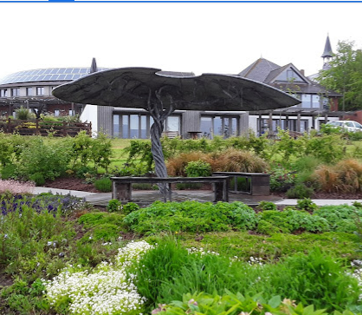
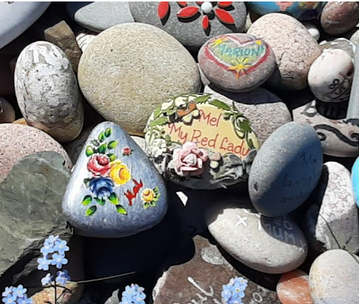

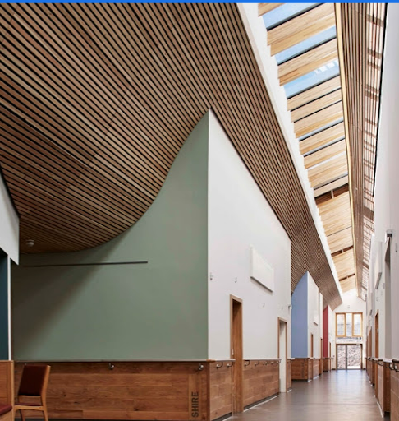
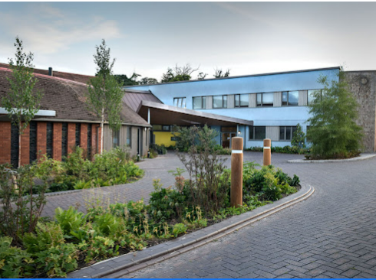
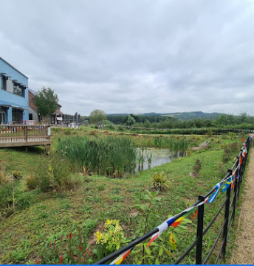

Slide 10
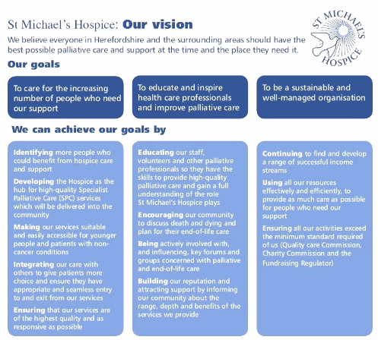

Slide 11
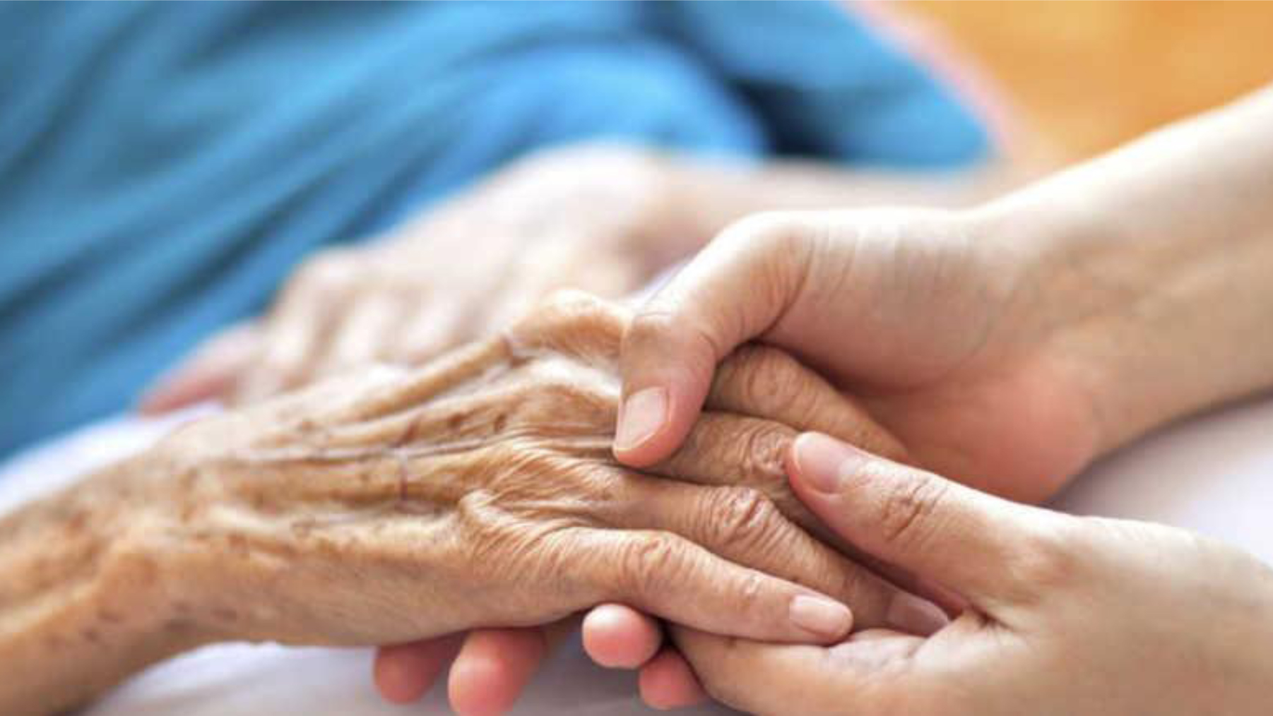
palliative care end of life care
This Photo by Unknown author is licensed under CC BY-NC-ND.

Slide 12
Palliative Care is an approach that improves the quality of life of patient's families facing the problems associated with life threatening illness, through the prevention and relief of suffering by means of early identification and impeccable assessment and treatment of pain and other problems, physical, psychosocial and spiritual.

Slide 13
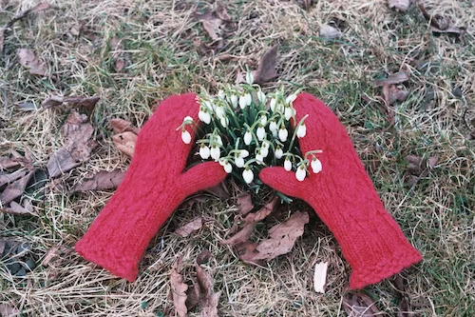
Palliative Care is an approach that improves the quality of life of patient's families facing the problems associated with life threatening illness, through the prevention and relief of suffering by means of early identification and impeccable assessment and treatment of pain and other problems, physical, psychosocial and spiritual.
WHO 2003

Slide 14
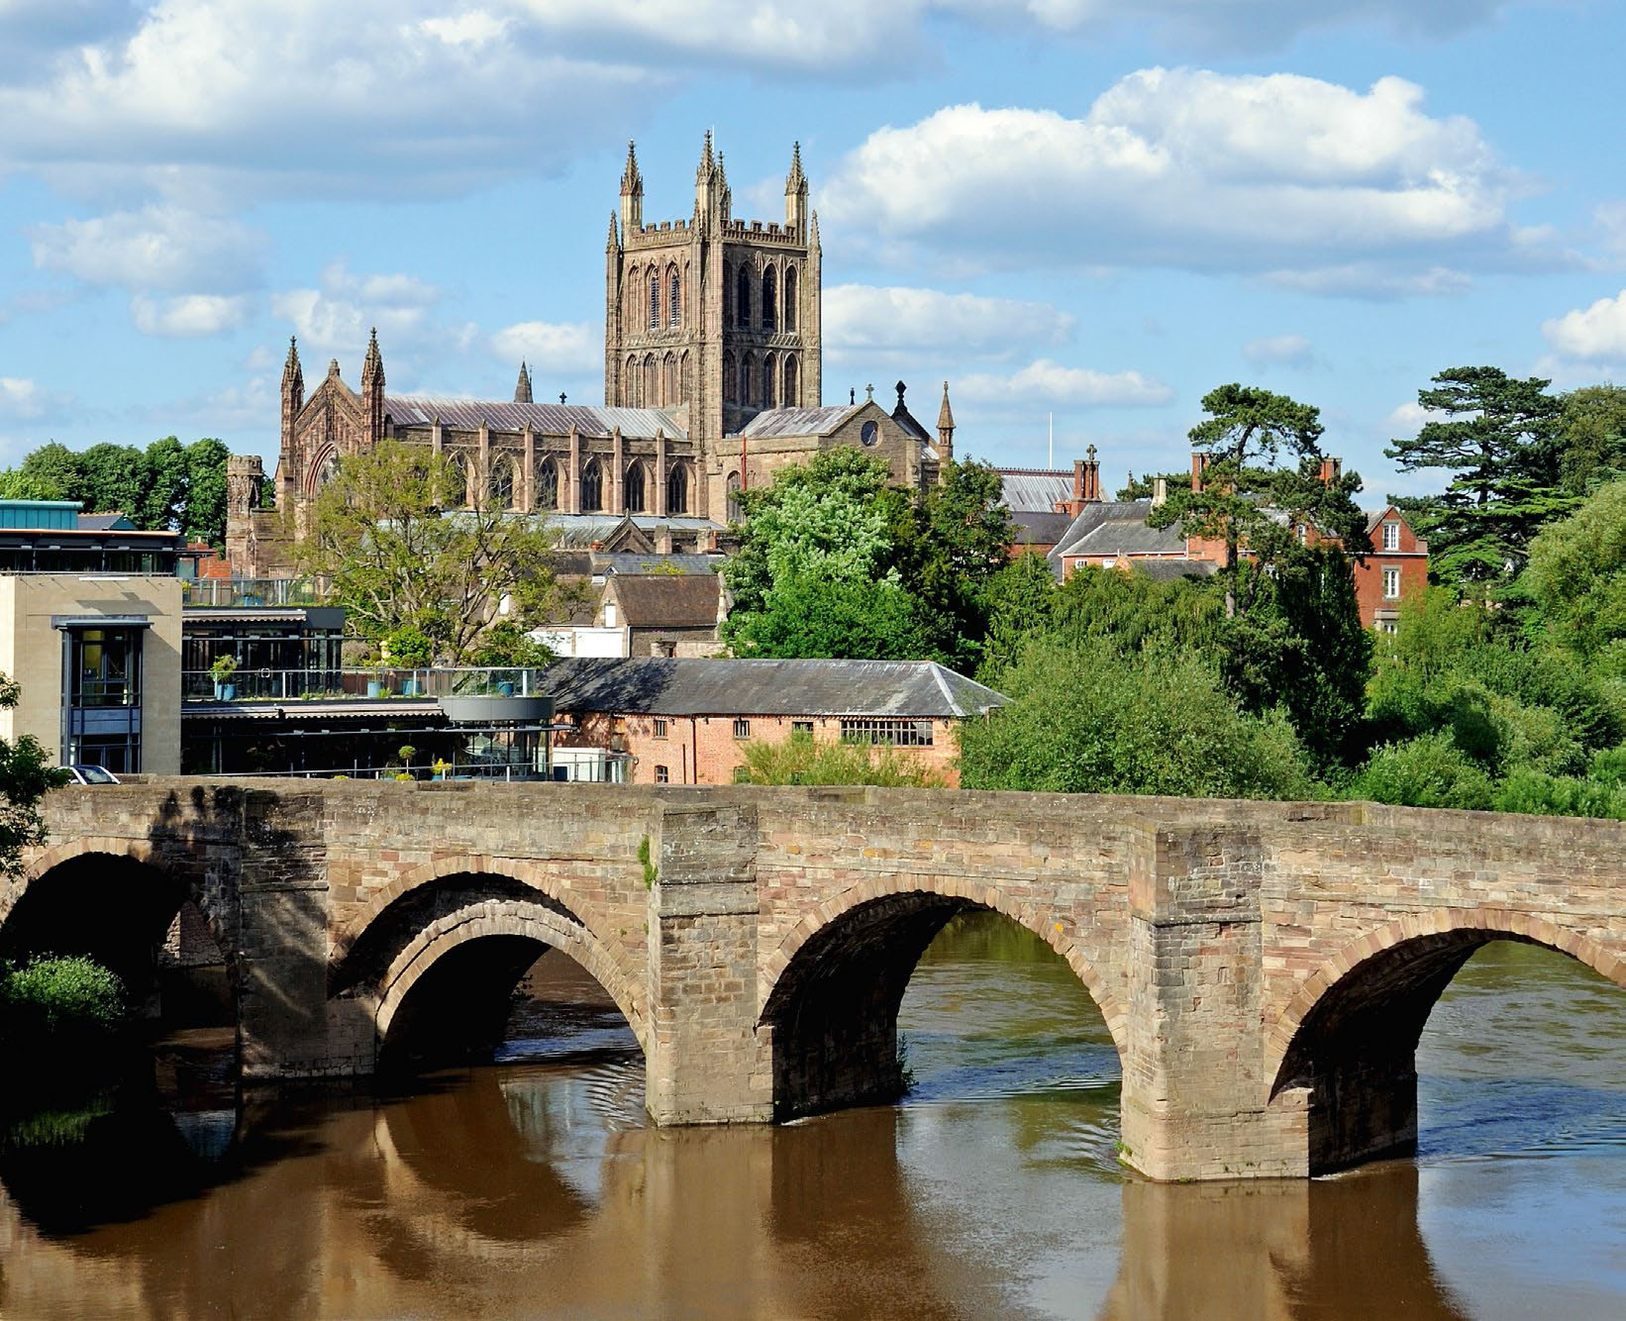
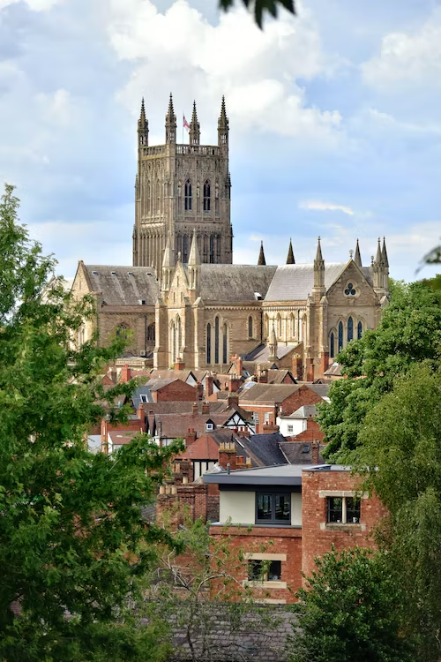

Slide 15
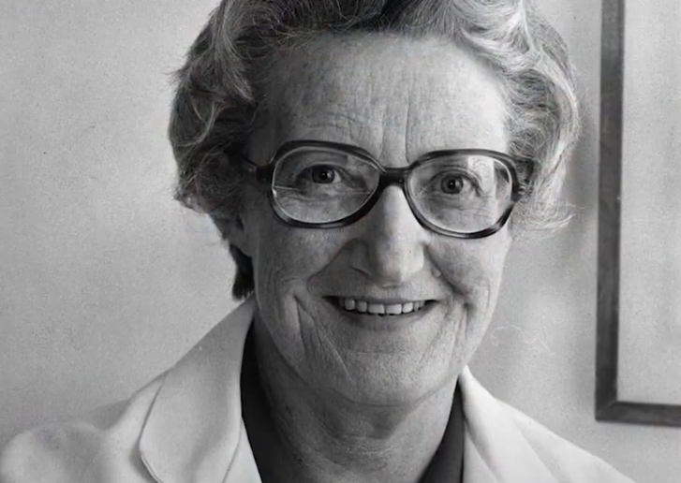
"You matter because you are you, and you matter to the end of your life. We will do all we can not only to help you die peacefully, but also to live until you die." ​

Slide 16
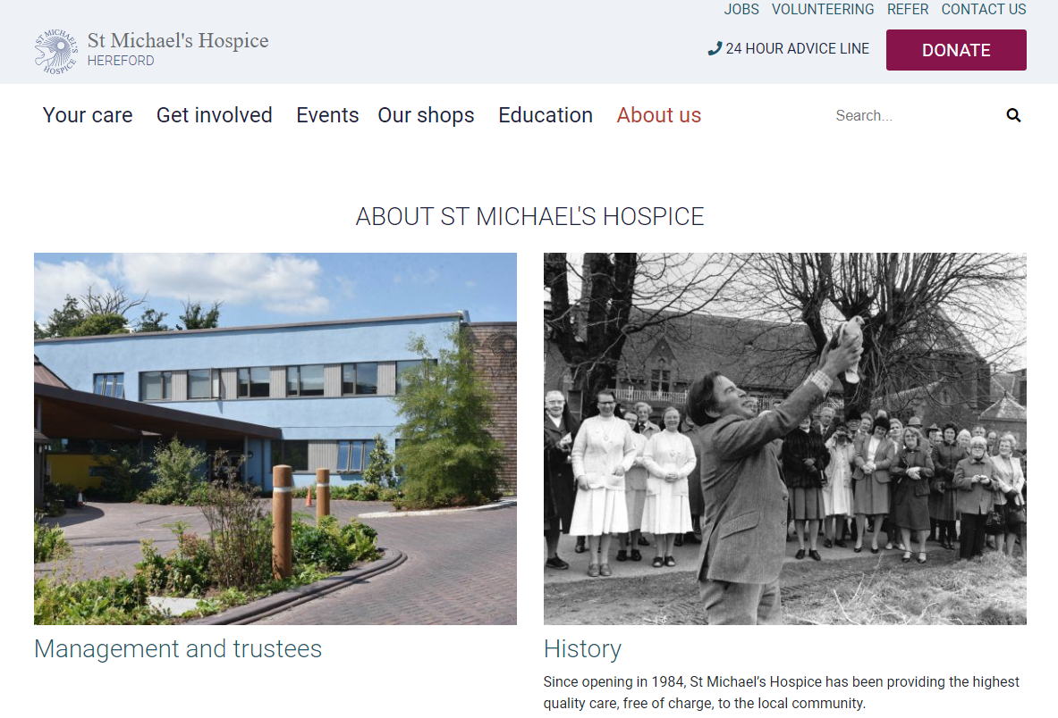
https://www.st-michaels-hospice.org.uk/about_us/

Slide 17

Will Lindesay - Chief Executive, hvoss
Ukraine Network – hvoice link
Meet the Funder - Herefordshire Funders Meeting - Talk Community and hvoss facilitated (hvoice link)
Youth Provision Forum – Eventbrite page for future events
hvoss AGM - 6th December 2 -4pm @ NMITE
24th March 2022

Slide 18
Talk Community Strategic Review
Herefordshire Council is undertaking a strategic review of Talk Community
The community partnership are invited to a workshop which will form part of the review
Thursday 14th December 9:00-12:00
The Kindle Centre
Book your place: https://t.ly/6Zt-0
24th March 2022

Slide 19


State of the Sector Research part 2
Will Lindesay, hvoss & Emily Lowe, Talk Community
24th March 2022

Slide 20
State of VCSE Sector Survey
Round 2

Slide 21


State of The Sector research – phase 1
Commissioned by Herefordshire Council in partnership with hvoss
Aim to highlight what the VCSE sector in Herefordshire does
Demonstrate the value and diversity of the work it undertakes
How it contributes to the economy of the county
How it is an essential part of the fabric of society
250
Community and business networks
(

Slide 22
State of The Sector research – phase 1
Database of all VCSE in county. Total 2,304
On-line survey disseminated via infrastructure organisations and thematic sector networks
281 survey responses – 12% of the estimated number of VSCE organisations in Herefordshire
Local Infrastructure Organisations and stakeholders interviews
9 focus groups held, 5 thematic and 4 Primary Care Network areas
Set of recommendations
250
Community and business networks
(

Slide 23
Phase 2 – involving the sector
VCSE Steering Group
Greater ownership of the sector of the research and the findings.
Help to increase response rate target 20% (460)
Involvement in the research process – survey design, promotion of survey, reviewing results, content and dissemination of report.
250
Community and business networks
(

Slide 24
Phase 2 survey – working group
What worked well?
What do we want to improve?
How did you use the findings?
Are there any questions that aren’t useful or no longer relevant?
Are there any questions that people didn’t understand / weren’t clear?
Is there anything missing?
Consider the comparability of data
250
Community and business networks
(

Slide 25
Timescales
November 2023 | Final survey agreed
3rd January 2024 | Survey circulated (for 8 weeks)
28th February 2024 | Survey closes
11th March 2024 | Full comparative data analysis of survey undertaken
w/c 18th March 2024 | Interviews with Infrastructure organisation
May 2024 (tba) | Community Partnership workshop
3rd April | Draft report complete and circulated to Steering Group
31st May 2024 | Submission of final report
June 2024 | Survey published and shared
250
Community and business networks
(

Slide 26
Thank you.
Any questions?

Slide 27
Rob Thomas
Chief Executive
Vennture
Your views on Community Safety
24th March 2022

Slide 28
What is the Purpose of the Community Safety Partnership?
Identify local priorities via a strategic assessment, and
Reduce crime and disorder - including Anti-Social Behaviour, substance misuse and reoffending in each local authority area.
Core Activities
Assess & identify community Safety Priorities
Coordinate activities to address priorities in a 3-year rolling plan
Consult & engage with communities
Drive Prevention & early intervention - especially in relation to violence
What is in scope: Cross-sector coordination, core agencies engaging with communities to co-ordinate activities to deliver agreed priorities - especially in relation to driving prevention.
The CSP is about CROSS-SECTOR co-ordination specific to its defined priorities.
24th March 2022

Slide 29
Your views on Community Safety?
Workshop 20 minutes
What are the 3 most important priorities for the Community Safety Partnership to consider?
All views - Mentimeter
Table discussions: Discuss and agree on your tables the top 3
Feedback to the room
If your group or organisation holds data relating to community perceptions of safety, please put your name, org/group and contact details on the CSP sheet on your table.
Logging onto Mentimeter:
1. Go to your internet browser page and type in: menti.com
2. You will be asked for a code, type in: 1537 5650
3. Answer the question
24th March 2022

Slide 30

Dr Mike Hearne
Managing Director, Taurus Healthcare
Herefordshire General Practice
About General Practice
24th March 2022

Slide 31

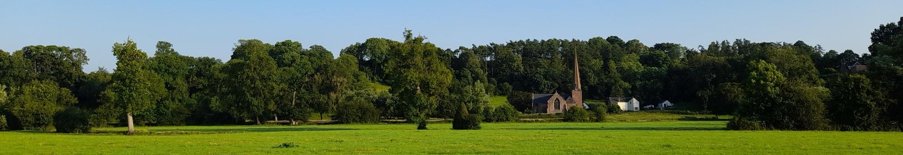
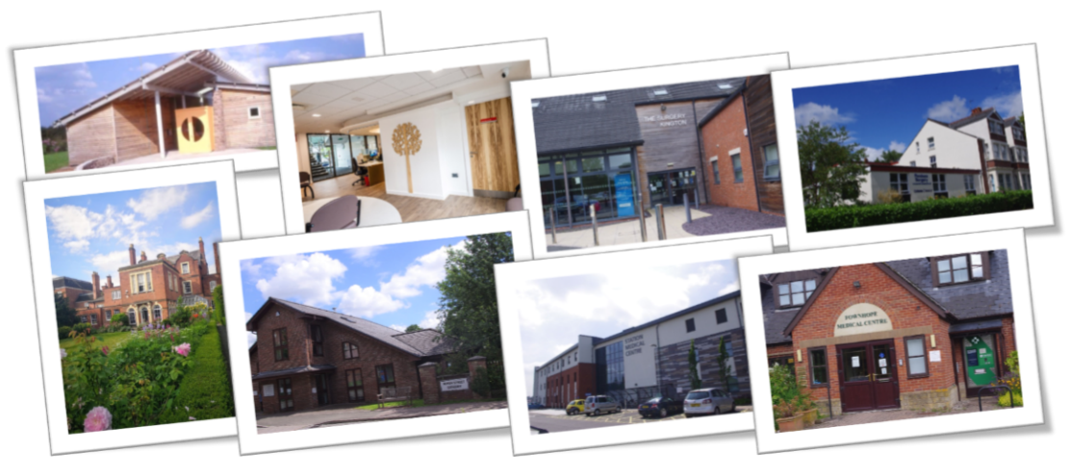
Herefordshire General Practice
A General Practice Collaborative

Slide 32

Purpose
The presentation will aim to:
Explain the pressures in general practice
Provide an overview of the new ways of working in general practice
Describe our unique leadership approach to co-ordinate our voice and delivery
Discuss opportunities to collaborate with communities and VCS

Slide 33
Key facts about general practice
Lives with real money
Left shift (movement of work from secondary care into community) if unfunded is paid for by GP partners
GP practices & Taurus are NHS Family- legal provision of pension
90% of NHS contacts are primary care
GMS contract was negotiated with an average 4 consultations year in 2004, balancing mechanism was DDRB- which was ignored until very recently
Herefordshire practices currently providing 7-9 consultations/ pt/ year, and 3rd highest GP access data in country
Reducing numbers of GPs: so seeing more people with less GPs

Slide 34
Introduction to Herefordshire General Practice (HGP)
Who are Herefordshire General Practice (HGP)?
HGP is a collaborative made of up the following organisations:
19 Herefordshire Based GP Practices
Primary Care Networks (General Practice Component)
Taurus Healthcare Ltd
Local Medical Council (LMC)

Slide 35
Our Delivery Model
How does it all fit together?
Federative Support
Hereford Medical Group (HMG)
Clinical Services Network
(at scale delivery)
WBC PCN
Infrastructure Support
19 GP PRACTICES
East PCN
South and West PCN
North and West PCN

Slide 36
The rationale for change
General Practice is keen to cement its position as a peer at both place and across ICS
CCG to ICS has reduced the infrastructure & leadership/ support of general practice
This formalises the previously informal approach of GP Leadership Team
Formalises the voice of general practice between LMC, Taurus, Clinical directors
Enables a platform ready to host and deliver new general practice contracts

Slide 37
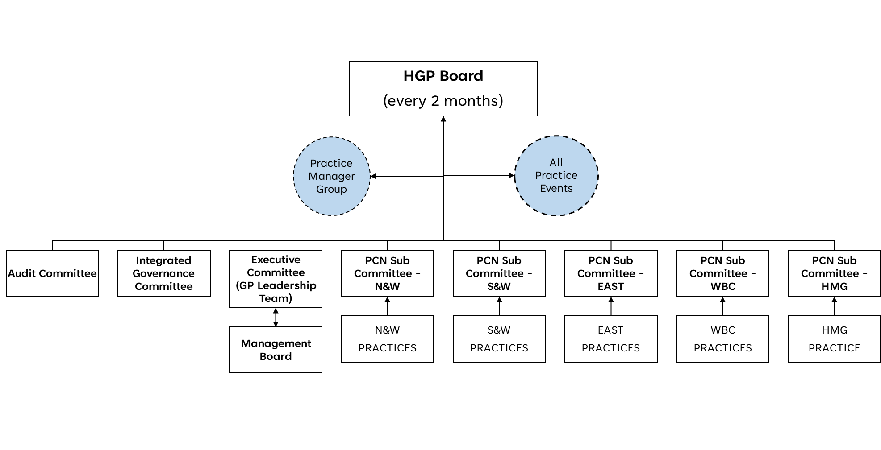
Governance
How does the decision making, and the information flows work?

Slide 38
HGP Collaborative
What are we trying to achieve?
General Practice resilience: To promote and practically support General Practice sustainability
Change leadership: To support primary care through complex and transformational change
Singular representation: To help present a unified ‘face’ of general practice, promoting collaboration across partners, facilitating a united position on system issues, and avoiding fragmented approaches
Innovation: To drive innovation through improvement methodologies and other techniques, underpinned through strong engagement with practices, our ability to test out new approaches and a focus on delivery
System contribution: To ensure primary care help lead systemwide change, promoting sector identity and credibility with system partners + change focus from reacting to PREVENTION

Slide 39

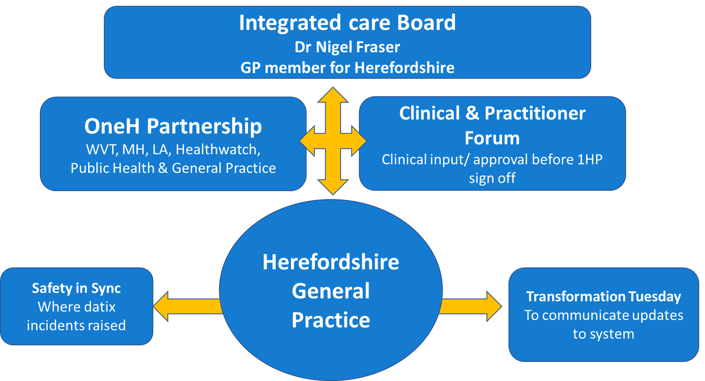
How does general practice link into the ICS?

Slide 40

What are the challenges facing Herefordshire General Practice?
Changes to funding arrangements and budgetary pressures
Recruitment challenges, falling number of GP partners, pressure on existing team
Increasing workloads, eg ‘left shift’ from secondary care especially with the backlog
Increasingly complex population health needs
Public perceptions and understanding regarding General Practice
Negative publicity around access to GP services “I want to see my GP”
Fire-fighting, limiting move towards prevention

Slide 41
What is Herefordshire General Practice doing to address these challenges? (continued)
1. At scale where it makes sense
We run out of hours services so all services are joined up across 24/7 to improve continuity
Evening and weekend appointments available at 9 hubs throughout the county
Herefordshire Remote Health service (HRH) – an innovative approach to supporting patient’s on the day consultation needs
2. New additional roles eg social prescribers, wellbeing coaches, safeguarding coordinators, nursing home coordinators/ support, physios, pharmacists
3. Data: Business intelligence: we can search across all GP surgeries for activity, diseases, spotting trends etc
4. Communication
Campaign based communications activities: new roles and PCNs explained on https://www.herefordshiregeneralpractice.co.uk/our-practices/primary-care-network-management
Engagement/representation activities across Herefordshire General Practice & Pathway change
5. Access recovery Plan
6. Prevention
7. Partnership working

Slide 42
Key principles of our model across 24/7:
There is a continuum between urgent and planned care –
The distinction is for service providers, not patients
Right care at the right time
Same day access vs continuity within a team
MECC and services that work together rather than in isolation (OOH, EA and HRH service) builds resilience and improves sustainability for core general practice
Continuity of care (especially for complex patients) reduces costs to the system and improves quality
Integration with place
Appropriate use of digital and virtual support, can free up our GP practice and PCN teams to deliver more face to face: They are our hubs
Use of the patient record in emis across 24/7, supports continuity and proactive personalized care – critical to reducing inefficiency/managing risk

Slide 43
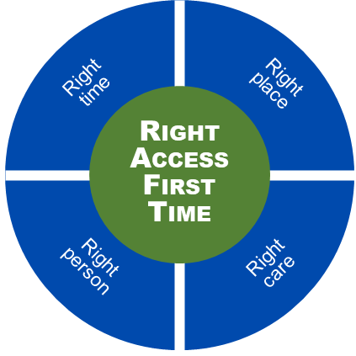
Next Steps: Access “Recovery” Program
Reducing Demand
Digital front door
Secondary care/ primary care interface
Care navigation
Integrated Neighbourhood Teams
As part of Fuller
Integrated Urgent Care
Localised 111
HRH expansion with CIRH/ hospice, VW etc
Improve Pathways
MECC/ Care nav
Standard website approach
Increase continuity where needed
Cross- org appointments
DOS in community (LIVE)
Increase Capacity
Integration with partners
Increased HRH remote
Use of HRH for clinical admin
Flexible workforce roles

Slide 44
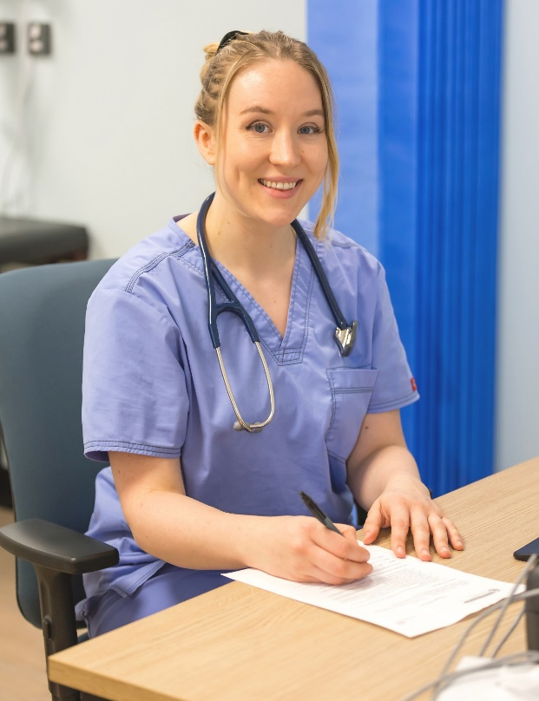
Herefordshire Remote Health (HRH)
A team of GPs, Physician Associates and Advanced
Practitioners, supported by admin and IT
Who helicopter between practices
Providing additional support to the duty day
“Do you feel your issue can be managed on the telephone/via video?” Yes
“Do you need to see a particular member of your usual practice team for this?” No
= HRH will support
Can provide same day increase in appointments / network to prioritise practices in urgent need

Slide 45


Talk Wellbeing
Update September 2023

Slide 46

Purpose
Bringing together a range of prevention pathways to support a more effective and accessible approach to providing healthcare interventions to our underserved communities, delivering a positive patient experience.
Target populations
• Unregistered populations
• Seasonal and Farming communities
• Those living in areas of high deprivation
• Those for whom English is not their first language
• Hesitant populations
• Migrant communities
• Rural communities
• Digitally excluded

Slide 47

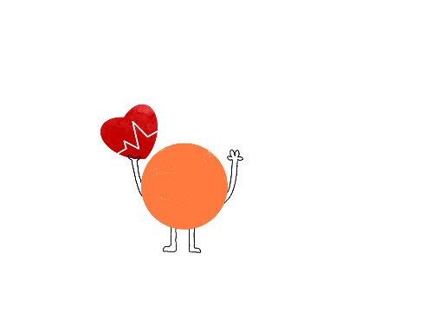
Outcomes (total appointments: 202)
(17.07.23-13.09.23)
3 patients have been registered at a GP Practice through Talk Wellbeing
20 patients with moderate/high QRisk status
10 patients with a high blood pressure
18 patients with high cholesterol
112 contacts with a social prescriber
68 health checks completed
Key themes of contacts
Homelessness
Access to food
Advice on housing
Signposting to Benefit support and reviews
Too busy to go to practice

Slide 48

So what impact are we making?
Top 10% UK Appointment activity
Quality reporting across all practices for incidents & learning etc
Demonstrating the value of general practice
Resilience of workforce with flexible opportunities and career development
Increasing Prevention
Holistic, continuity of care at the heart of what we do
Future proofing with new structures to allow general practice to hold contracts and act as a leader & peer in the ICS
Top 3 in UK for delivery of Covid Vaccination
Lowest in UK for A&E attendances that should be seen in primary care

Slide 49
Opportunities for General Practice & Community Partnership
Right place right time
Moving upstream towards prevention
Health does not have all the answers
Integrated neighborhood teams across a geographical needs to include communities
The more we work understand how each other works the more likely we can support each other

Slide 50
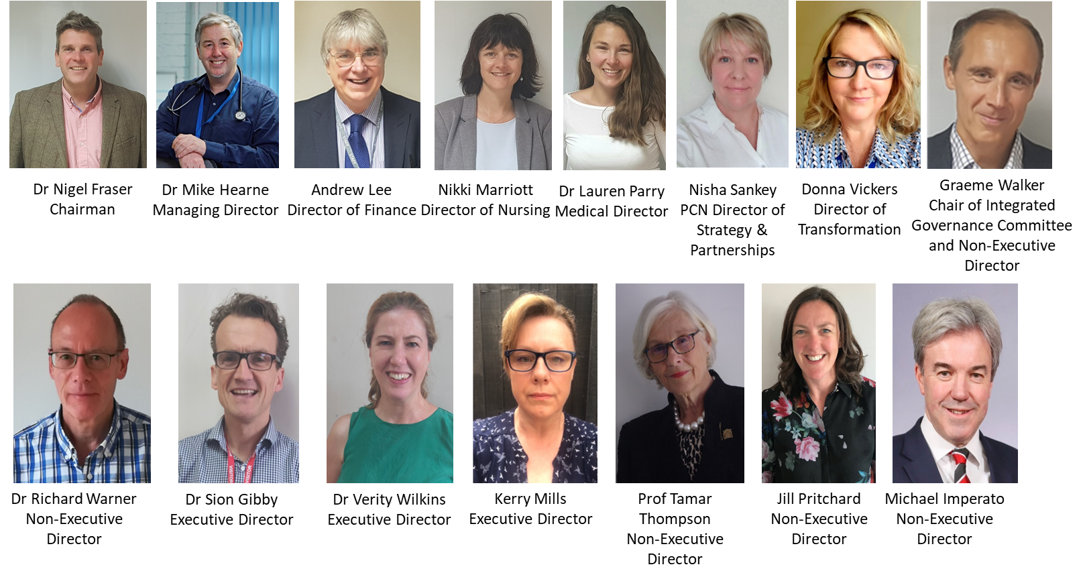
The HGP Board
Who is on the HGP Board?

Slide 51

Dr Mike Hearne, Managing Director
Mike.hearne@nhs.net
www.herefordshiregeneralpractice.co.uk
Notes:
Nish

Slide 52
Will Lindesay
Chief Executive
HVOSS
Community Sector Confidence Framework
24th March 2022

Slide 53
Christine Prince
Chief Officer – Healthwatch Herefordshire
Community Paradigm…next steps
24th March 2022

Slide 54
Community Paradigm Programme Manager
New jointly funded 12-month role to Work with the community sector and public sector partners to establish approaches and implementation plans for the following 6 workstreams.
1 An immersive walk-through training experience
2 Community led decision making and action, different voices in different places
3 Developing Community Chest Approach
4 Pilots and initiatives
5 Creating the enabling conditions for thriving communities
6 Build a strong Community Alliance that can sustain and drive this
For information on the opportunity visit www.healthwatchherefordshire.co.uk/work-us
24th March 2022

Slide 55
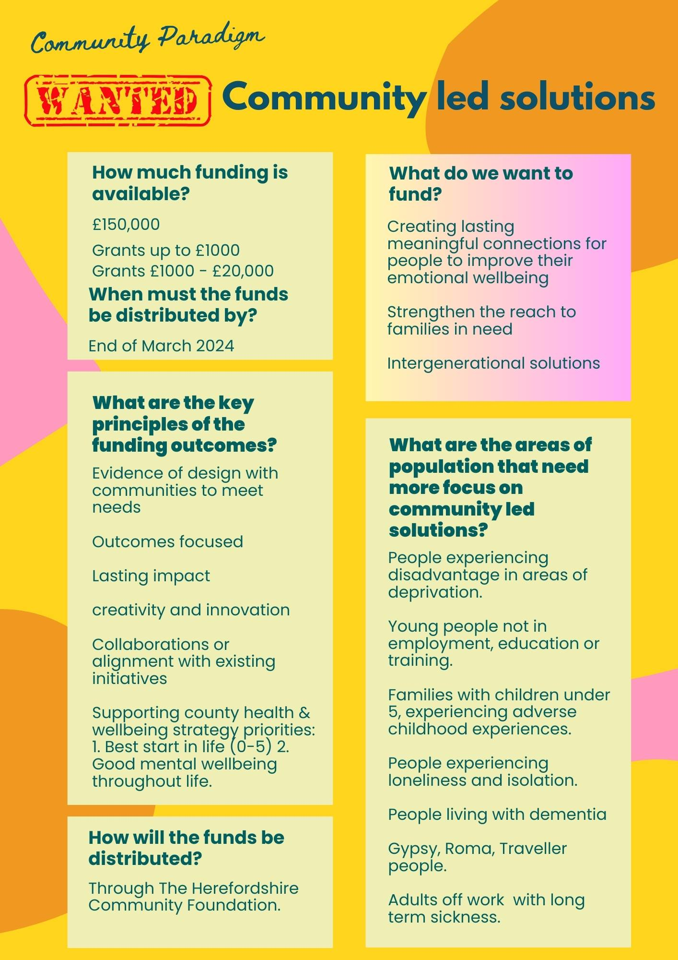

Community Chest
24th March 2022

Slide 56


Next Time ?
24th March 2022

Slide 57

Networking & Light Lunch
Join us at the next Community Partnership Event on Wednesday 31st January 2024.
Community Partnership enquiries to:
sam@healthwatchherefordshire.co.uk
24th March 2022

Slide 58
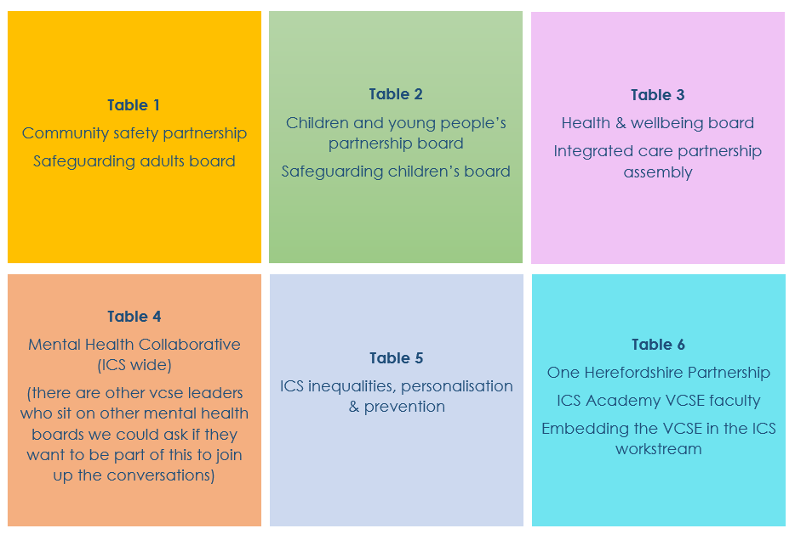

Slide 59
Stronger together
Why should we do this?
We need to be seen as a significant partner in the system with a clear voice.
We can start to develop the Community Partnership agenda together.
We can use this mechanism to upskill parts of the community sector.
We can identify common issues we need to be consistent and lobby on.
We can develop our Herefordshire VCSE mantra!
What kind of thinking do we need to start telling our reps in this unified approach?
What are the system issues you want your rep to be raising on behalf of the sector?
What do you want these boards sighted on? (e.g., initiatives happening in the community sector)
What do these boards need to know? (e.g., issues arising in communities, unmet need)

