Slide 1

20th March 2024
9:00-9:30 Arrival & networking
9:30-9:35 Introduction & Updates
9:35-10:15 Living with ADHD
10:15-11:15 ADHD Workshop
11:15-11:30 BREAK
11:30-12:00 Hd4 Consult Station PODs
12:00-12:30 Speed networking updates
24th March 2022

Slide 2

Christine Prince
Chief Officer – Healthwatch Herefordshire
Introduction & Updates
24th March 2022

Slide 3
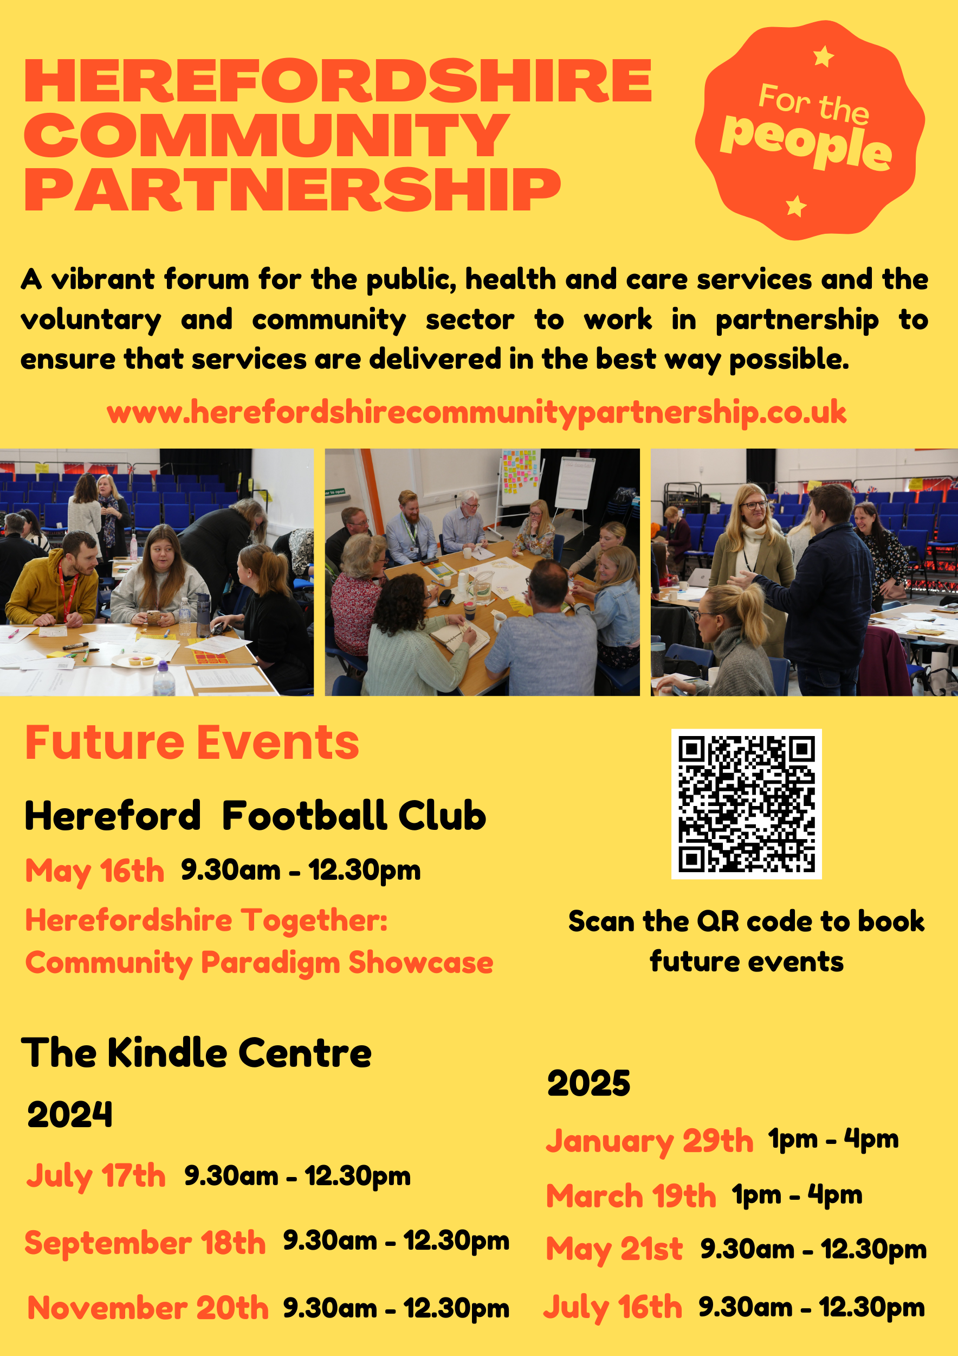
24th March 2022

Slide 4

All those that complete the survey will be entered into a draw to win £500 for their group.
2024 State of the Sector Survey…we need your help!
This is a really significant piece of research which will be used as an evidence base to ensure that the sectors story is told and helps demonstrate why the sector need to be properly resources, values and listened to.
The research has been commissioned by Herefordshire Council in partnership with HVOSS.
The survey closes on 28th February 2024 DEADLINE EXTENDED 22nd March
24th March 2022
https://www.surveymonkey.com/r/State_of_VCSE_Sector_Phase2

Slide 5

Healthwatch Herefordshire Carers Survey
** We are looking to speak with paid & unpaid carers in Herefordshire**
We’d like to gather lived experiences of all ages, to identify the impact and challenges caring for someone has.
We strive to identify what is working well and what areas need improvement.
Working with Herefordshire Council, we will ensure that shared experiences help influence the current Carers Strategy Review.
Please speak to Sam from Healthwatch who can share the carers survey link with you.
Sam@healthwatchherefordshire.co.uk
01432 277044

Slide 6
Samantha Jenkins– Healthwatch Herefordshire Living with ADHD in Herefordshire - Report
24th March 2022

Slide 7

What is ADHD ?
ADHD is a disorder that is defined through analysis of behaviour. People with ADHD show a persistent pattern of inattention and/or hyperactivity-impulsivity that interferes with day-to-day functioning and/or development

Slide 8
Background & Objectives
We wanted to hear from people living with ADHD to understand the impact of living with the condition, current experiences of services and support available in Herefordshire.
Why? We have received an increase in feedback to Healthwatch about long waits for diagnosis and support both locally and nationally.
During September - December 2023 we spoke with 18 individuals about their journey so far and the wider impacts ADHD has had for them and their families.
These were detailed semi structured interviews lasting between 45 minutes to 2 hours in an environment of their choosing. This was a listening project.
We looked for themes in the feedback to develop the findings in this report.

Slide 9
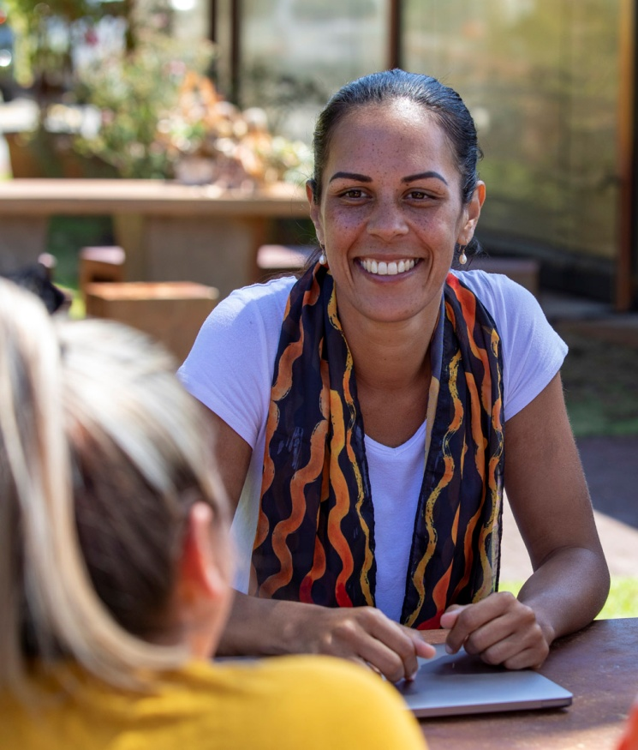
What did we want to achieve?
Increase understanding locally of the impact of living with ADHD.
Identify ideas & suggestions to improve education, training and awareness through the sharing of the lived experience and accurate information.
Provide recommendations to support advocacy for ADHD, promoting the needs & rights of individuals to share with educators, employers and policy makers to encourage implementation of support and adjustments.
Explore the potential to build community support networks through the sharing of experiences & insights of those living with ADHD and their families.
Provide insight to the NHS and Healthwatch England about what could be addressed when considering future models of support for ADHD.

Slide 10
What we heard
Every journey that we heard was unique, none of them could be described as easy or straightforward, but some had been less traumatic than others.
All the individuals we spoke with felt that a formal diagnosis would make / or has made, a significant difference to either to them or their child
Conversations were emotional and often when parents spoke about their child's ADHD journey it was very clear to hear the frustration in delays and navigating the access to services, the lack of formal support and recognition along the way and in some cases discrimination towards parents.
Many individuals told us a formal diagnosis has helped them access the right statutory support (SEND registration or PIP benefits) but few expected a diagnosis to automatically open doors to new levels of support, but this would be invaluable to many when needing support with employers.

Slide 11
‘This has impacted my whole life and when I look back on my younger self, I feel so sorry for myself and so sad.’
‘Getting the diagnosis was a big thing for me. I understand my life now, I feel that I have got the power back; I have an opportunity to rebuild, unlearn a lot of things that I’ve thought about myself, try to get back some confidence.’
‘What is the point of going to the GP as they don’t know, they didn’t even know about Right to Choose and I had to take the NICE guidelines to the GP to be referred, so they will not know the answers to my questions.’
‘I was told that it was because I was a single parent and the behaviours were down to my parenting skills, they think your child is bad, that he has bad behaviour and that you are a bad parent … even your own family. Many times, I felt judged’.
It’s difficult because you don’t want him to be labelled, but my understanding is that without the label you don’t get the support…a label helps him access the support he needs.’

Slide 12
Report recommendations…
Use existing networks setup within the county – such as parent carer forums, Talk Community Hubs etc to provide specific ADHD networking opportunities. Bringing those with ADHD in a local area together to build a support network for each other.
Support Primary care services to provide more knowledge to those waiting for a diagnosis of ADHD – e.g. group support sessions, local peer support, digital resources e.g. utilise some of the national support organisations, so individuals feel like they have a next step and a place to go while waiting for a diagnosis.
Primary care services educated on the offer the ‘Right to Choose’ – where this is given as an option to patients it has sped up referrals.
Creating support networks for parents through schools on a very local level – together they can support each other and their families.
Providing opportunities to facilitate basic training sessions for local employers to understand ADHD to best support employees with the condition, both reasonable adjustments and to keep them engaged in their employment and allow them the same opportunities for career progression.
A local support service that provides advocacy & support for adults and older children with ADHD that can support them with occupational issues, routes into work and improving life skills to help them keep a routine with ‘life admin’ and studying

Slide 13
Experience experiment
24th March 2022

Slide 14
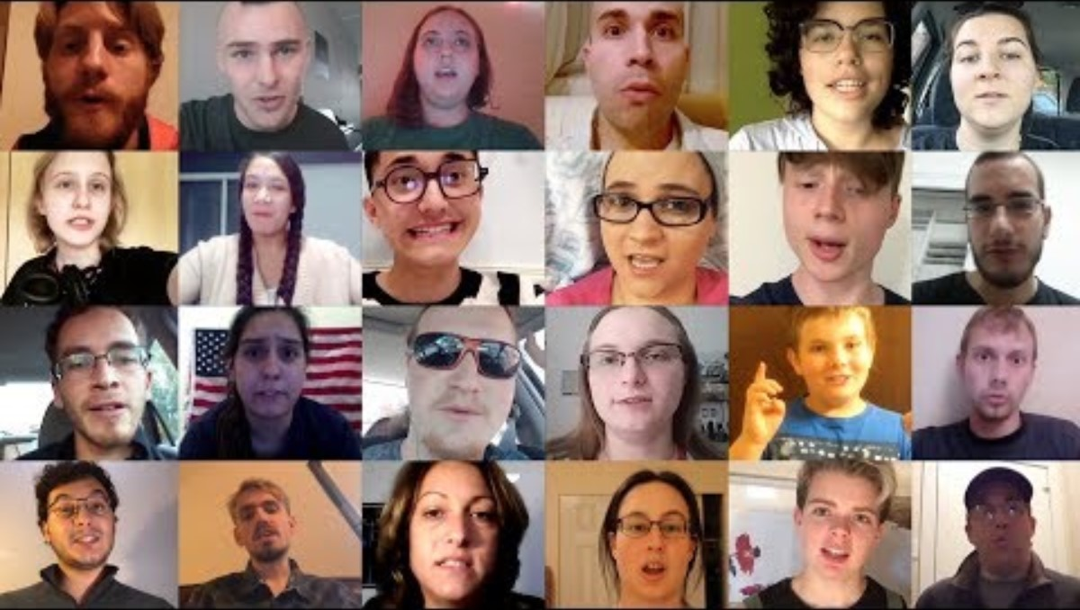
24th March 2022

Slide 15

Kate Richards– Herefordshire Mind
Lived Experience ADHD
24th March 2022

Slide 16

KATE RICHARDS
ADHD
MY EXPERIENCE
~15 MINUTES

Slide 17
ABOUT ME
Content
MY DIAGOSIS
SYMPTOMS
EDUCATION
WORKING LIFE
2 / 16
WHAT HELPS

Slide 18
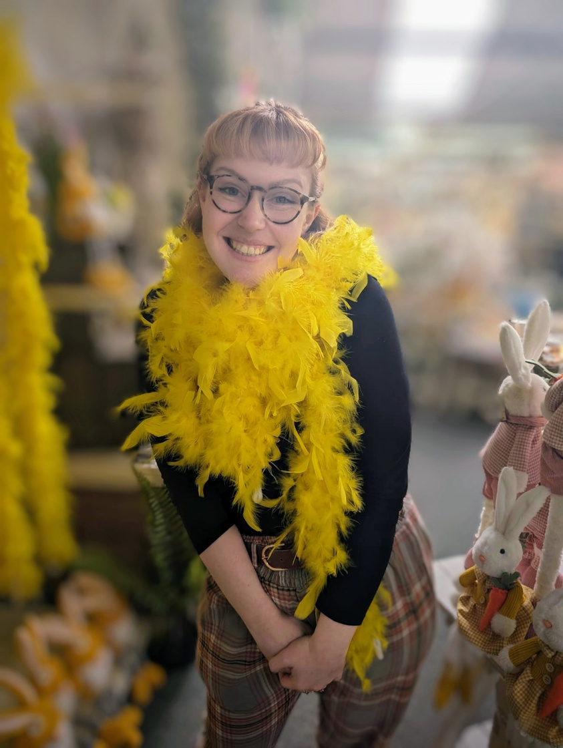
PROFILE
About Me
KATE - 27 - MENTAL HEALTH MANAGER, MIND
Zoology degree
Loves books (I read 41 last year)
Perfectionist - hobbies change weekly
Was on The Chase (yes, I will sign autographs)
3 / 16

Slide 19


Diagnosis
GP - Right to Choose - Referred to Psychiatry UK Feb 2023
Assessment - Feb 2024 - Written confirmation March 2023
-------
Initially I felt happy, that I was right and that I had answers
After getting my written diagnosis it started to feel real
4 / 16

Slide 20
Symtoms
Inattention
Difficult to listen when spoken to directly
Easily distracted
Forgetful in daily activities
Hyperactivity
Talks excessively
Blurts out answers
Interrupts
Fidgets
9 / 16

Slide 21
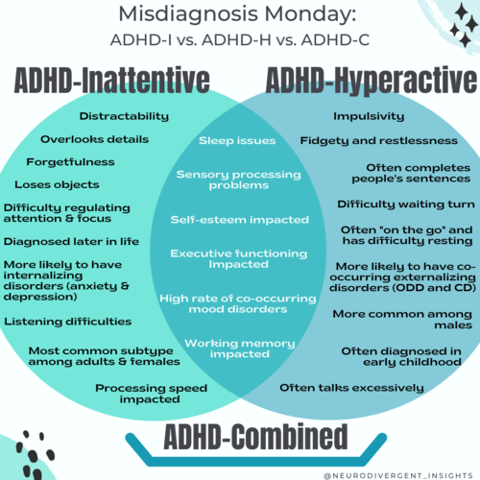
ADHD-I is characterized by difficulties regulating attention
ADHD-H is characterized by impulsive and hyperactive behavior
ADHD-C is characterized by both inattention and hyperactivity/impulsivity
WWW.REALLYGREATSITE.COMHTTPS://NEURODIVERGENTINSIGHTS.COM/MISDIAGNOSIS-MONDAY/ADHD-VS-ADHD
10 / 16

Slide 22
EDUCATION
UNIVERSITY
SECONDARY
1ST CLASS
Focused more on interesting modues
Masters - hyperfocused
MIDDLING
PRIMARY
Struggled to do well in all topics
Average grades
EXCELLING
Moved forward a year in maths
Always caught talking
5 / 16

Slide 23
Working Life
10+ years in Hospitality
Volunteering- Herpetology
Volunteering - Mental Health
3+ Years at Herefordshire Mind
Future plans...?
6 / 16

Slide 24


Working Life
Clear instructions/ deadlines
Room for questions
Schedules/ To Do lists
Routine
No clarity of what’s expected
No structure
Late rotas
No written processes
7 / 16

Slide 25

What Helps?
Patience
Understanding
Learning to work with it
No blame
Reasonable adjustments

Slide 26
Thank You
Questions?
kate.richards@herefordshire-mind.org.uk

Slide 27
Workshop Part 1
Pledge: What can you as an individual contribute to ‘providing peer support for ADHD in Herefordshire’?
24th March 2022

Slide 28
Workshop Part 2
As well as creating local peer support networks for ADHD, what else could be done to make Herefordshire a more inclusive place for people living with ADHD?
24th March 2022

Slide 29

Jess Howdle– University of Worcester
Research PODs in Herefordshire
24th March 2022

Slide 30

Jess Howdle- Research Associate
j.howdle@worc.ac.uk

Slide 31
Community consultation
On behalf of Herefordshire and Worcestershire ICB, University of Worcester are carrying out a community consultation on a Consult Station®.
Exploring how the community:
feel about the Consult Station® in Herefordshire
whether they are confident to use it (GP consultation and health research)
what is appealing and concerning
where one could be located in Hereford as a trial.

Slide 32
H4D Consult Station- A telemedicine booth which the public can carry out a range of clinical checks and measurements, and interact with a GP/Physician etc. or researcher via video link, confidentially.
https://www.youtube.com/watch?v=Si__3B9e0gM

Slide 33

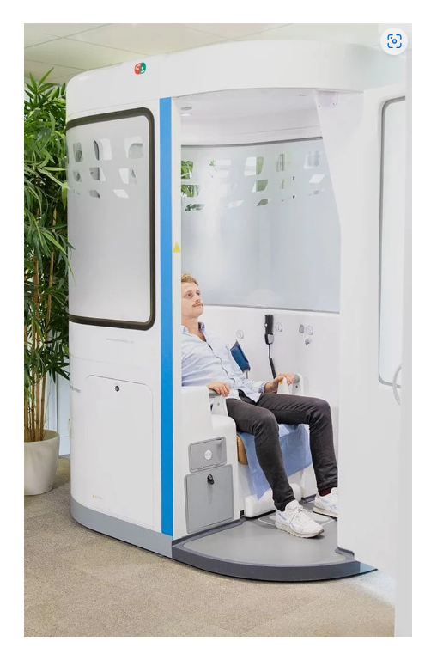

Slide 34

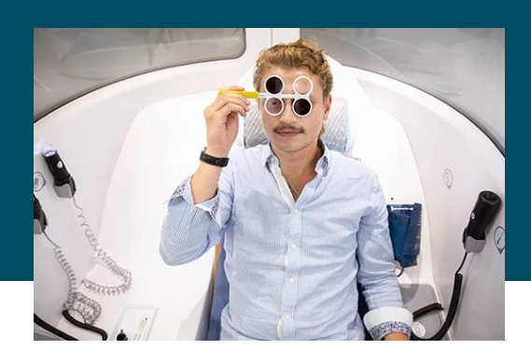

Slide 35
Your speed updates !
24th March 2022

Slide 36

Networking & Light Lunch
Join us at the next Community Partnership Showcase Event on Thursday 16th May 2024 at Hereford Football Club
Community Partnership enquiries to:
sam@healthwatchherefordshire.co.uk
24th March 2022

