Slide 1

9:00-9:30 Arrival & networking
9:30-9:35 Introduction & Updates
9:35-9:55 The Importance of Listening & Engagement
9:55-10:20 Welcome to Herefordshire Together
10:20-11:20 Herefordshire Together Grant Winners
11:20-11:30 BREAK
11:30-11:50 Community Organising & Citizens Herefordshire
11:50-12:00 Friends of the Castle Green, Listening at a local level
12:00-12:30 Mini Community Organising Event
24th March 2022

Slide 2

  Christine Price
  Chief Officer – Healthwatch Herefordshire
  Introduction & Updates
24th March 2022

Slide 3

  Professor David Croisdale-Appleby
  Chair - Healthwatch England
  The importance of listening & engagement
24th March 2022

Slide 4

  Simone Thompson
  Community Paradigm Program Manager– Healthwatch Herefordshire
  Welcome to Herefordshire Together
24th March 2022

Slide 5
Bringing Herefordshire Together

Slide 6

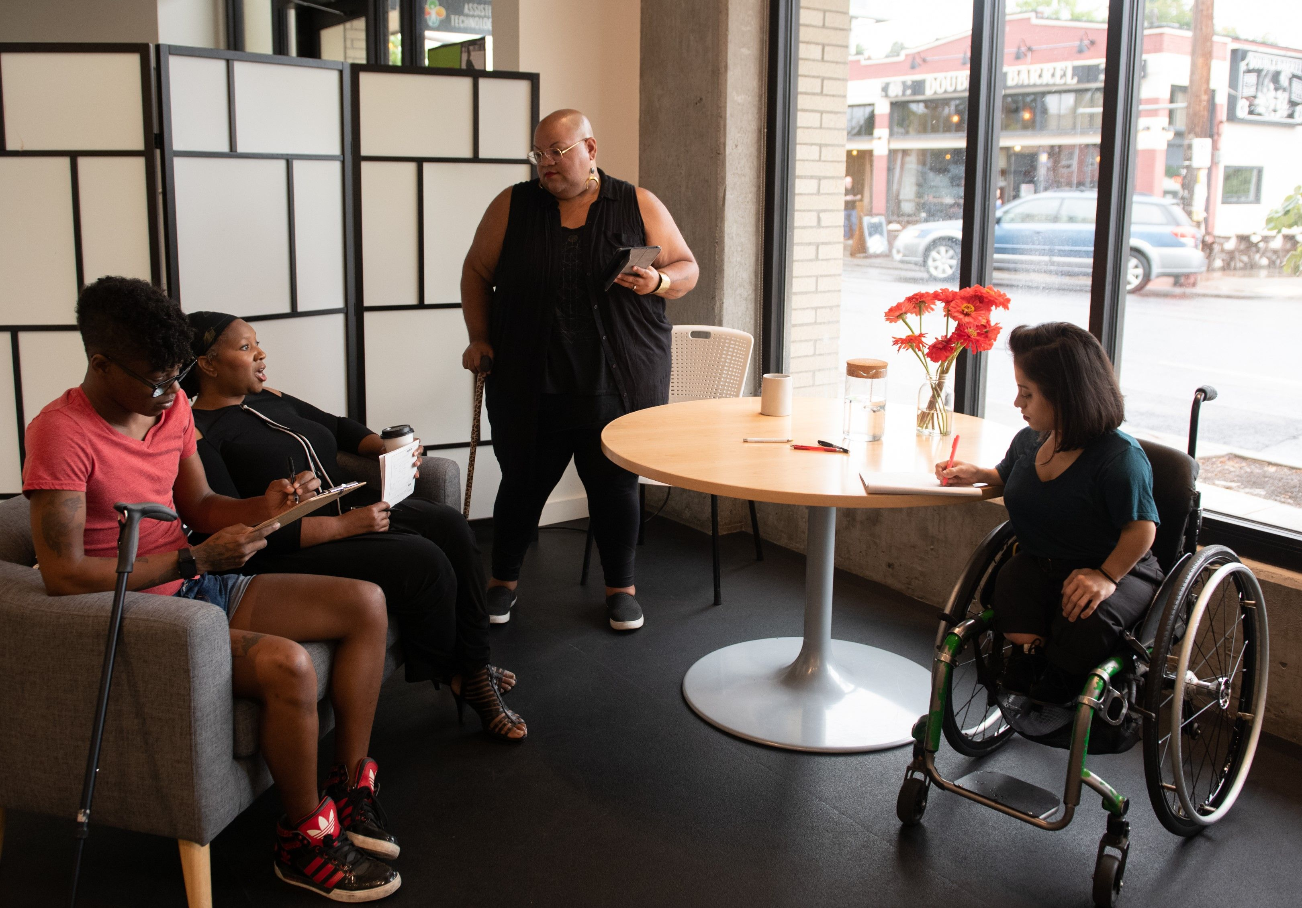
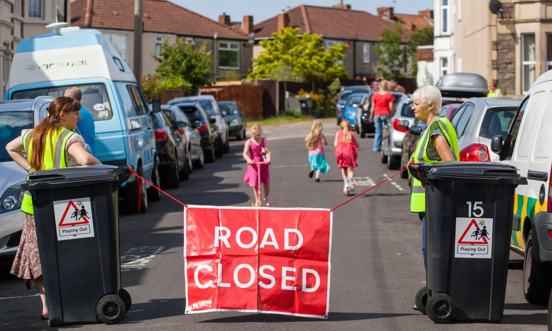
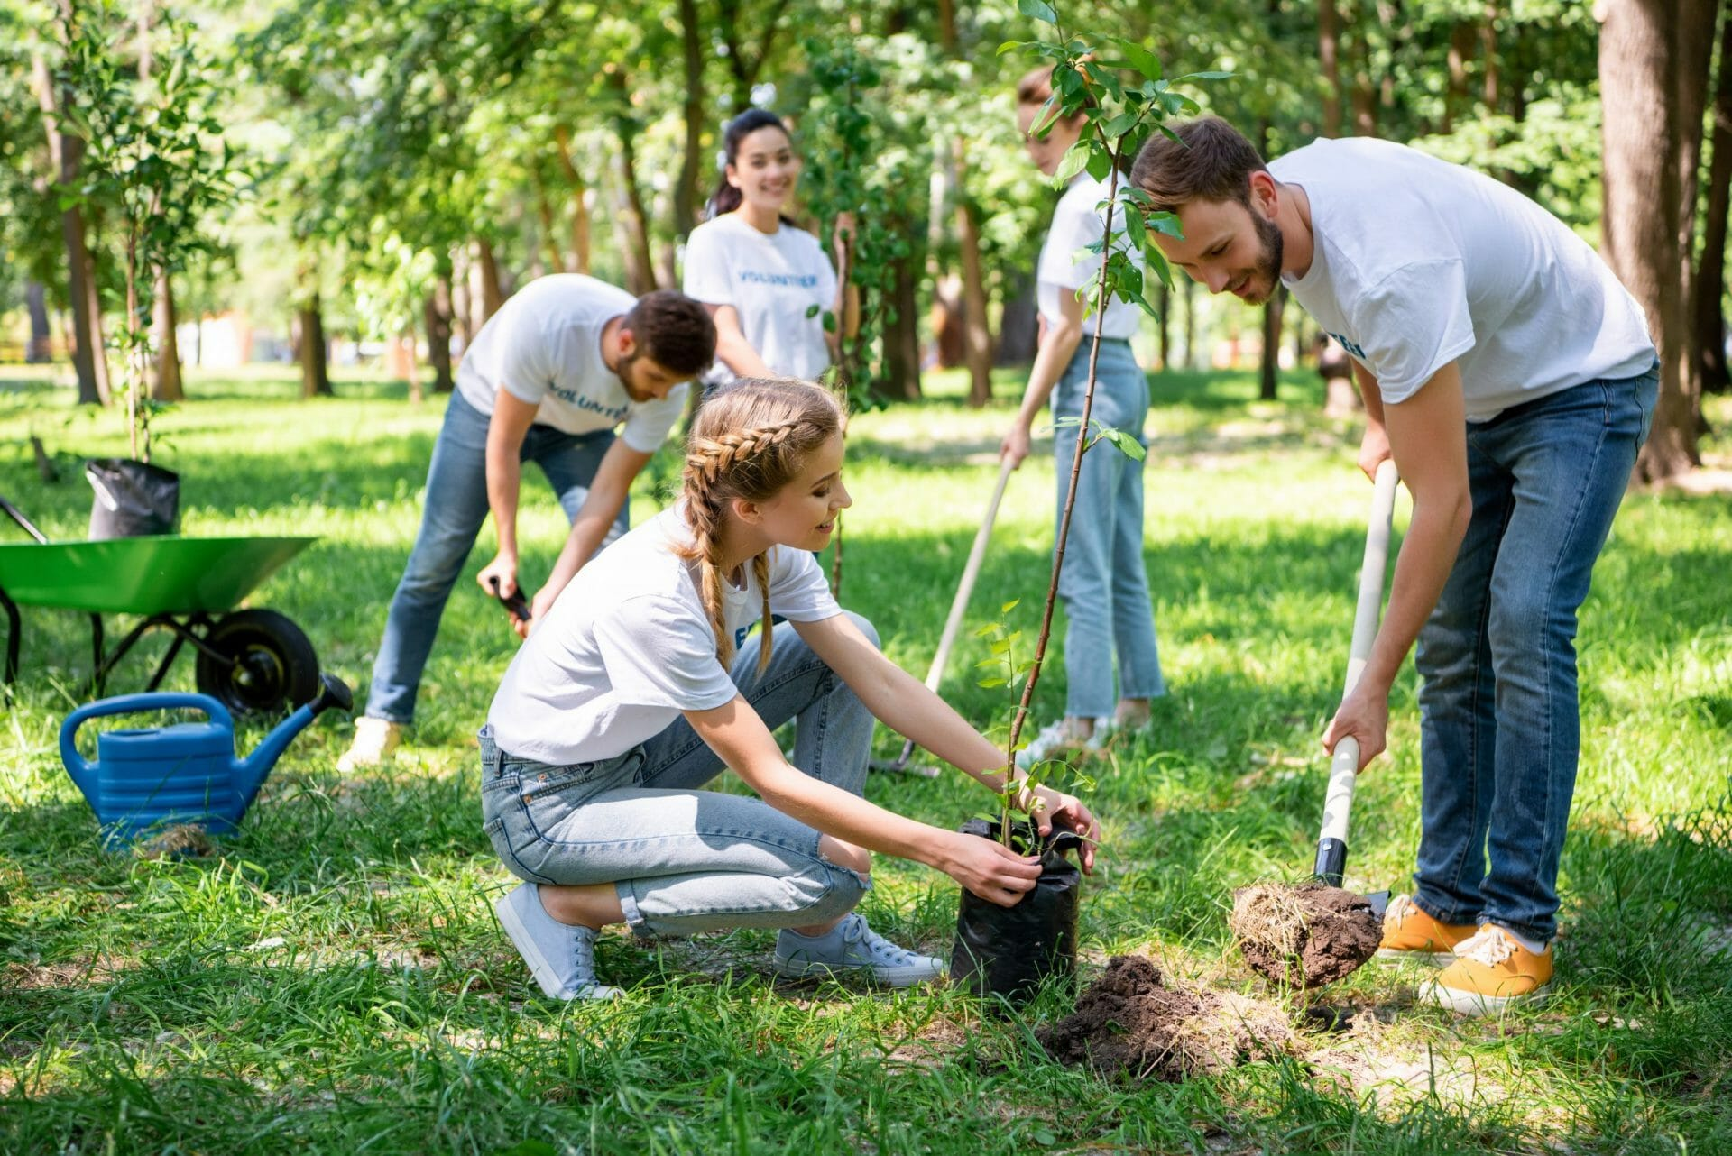
What do we want Herefordshire to be like in 10 years?
Thriving Communities
Our communities will foster wellbeing and resilience, where children and young people feel safe, loved, valued, and grow up with the confidence and skills to be the best that they can be.
Opportunity for all
There will be improved access to quality education and fair employment opportunities, with those who come from disadvantaged groups able to get jobs that pay a living wage, which enables them to improve the standard of living for themselves, their families and their community.
Healthy and Sustainable Places
People will grow, learn, live and work in environments that prioritise health and wellbeing where the healthy choice is the easy choice.
Healthy People
People will be empowered to take control of their health to lead healthy lives by reducing risky behaviours. Everyone will have equitable access to the information, services and preventative support they need, enabling them to access the right service at the right time.
Source: Herefordshire Joint Health & Wellbeing Strategy 2023

Slide 7
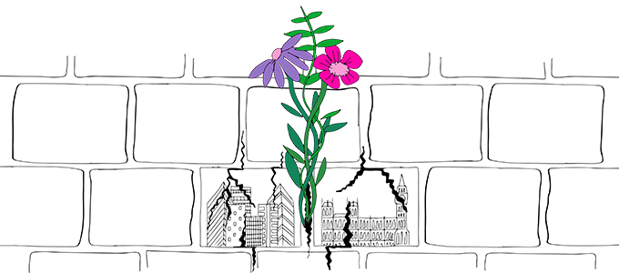
What is a Community Paradigm?

Slide 8
What is a Community Paradigm?
Why?
• The public service models of the last 60 years are broken, and a new approach is needed working in partnership with communities. Public sector services will never be able to create a state system big enough to address the demand now, or in the future.
• We must activate communities to work with us. Reduce demand, intervene sooner with community led solutions, and invest in prevention for better wellbeing outcomes.
What does creating Community Power mean?
• Community Paradigm describes a relationship and partnership between the state and communities. This is not a project; it is a complete overturning of the way public servants think and act.
• This is a fundamental change away from doing TO people, to building a relationship WITH people, to develop community solutions.
• This isn’t a quick fix; this is a long-term way of working.
• We need to look at our assets, which are our citizens, and transfer the power, resource and assets to communities. We need to treat people with respect and trust communities with the resource.
An example of community power and a paradigm shift:
• The Wigan Deal made savings and invested £15m over 5 years. This funded over 500 projects in communities, coproduced by communities, and increased healthy life expectancy by 7 years and is continuing today.
• The approach of Wigan Deal required public sector to work on the culture, habits, and customs of the public servants across the system. To retrain all their brains to listen to people, walk in their shoes and avoid a tick box exercise.

Slide 9
Bringing Herefordshire Together – making the difference
For residents: resilient activated communities will design the interventions that will work best for them, receiving the right support as early as possible as close to community as possible.
For community organisations: will be invested in to support communities through community-led prevention initiatives.
  For public sector: investing in community prevention will reduce demand on future services and improve people’s wellbeing for the longer term.

Slide 10
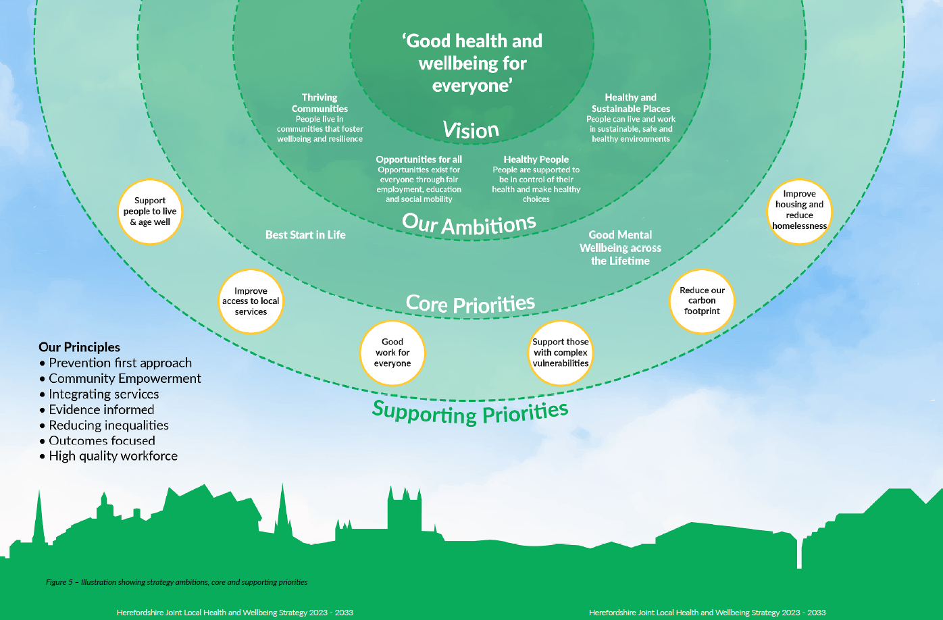
Tangible issues to address through Herefordshire Together

Slide 11
Driving forward Herefordshire 2033
Workstream 1 An immersive walk-through training experience
Aim: Understanding of the power of a community paradigm, communicate the shared vision for Herefordshire 2033.
Workstream 2 Community led decision making and action, different voices in different places
Aim: Community building, grassroots asset-based development
Workstream 3 Developing Community Chest Approach
Aim: Have a thriving community chest to fund and develop community led solutions to prevention
Workstream 4 Pilots and initiatives
Aim: in first £150k Increase connections for people to improve individual resilience and wellbeing
Workstream 5 Build a strong Community Alliance that can sustain and drive this
Aim: A sustainable vehicle and community led movement with a community powerbase
Workstream 6 Creating the enabling conditions for thriving communities
Aim: Community resilience for individuals, and a robust stronger VCSE sector.

Slide 12
Dedicated Program Manager – funded by all partners
Working with communities on where community power is making that change
12 Herefordshire Together projects piloting new ways of working and funding
Community organising underway – Citizens Herefordshire
Working with Wigan and other areas around the UK on what they have done differently
Listening to communities in order to build solutions

Slide 13
Driving forward Herefordshire 2033
Workstream 1 An immersive walk-through training experience
Aim: Understanding of the power of a community paradigm, communicate the shared vision for Herefordshire 2033.
Workstream 2 Community led decision making and action, different voices in different places
Aim: Community building, grassroots asset-based development
Workstream 3 Developing Community Chest Approach
Aim: Have a thriving community chest to fund and develop community led solutions to prevention
Workstream 4 Pilots and initiatives
Aim: in first £150k Increase connections for people to improve individual resilience and wellbeing
Workstream 5 Build a strong Community Alliance that can sustain and drive this
Aim: A sustainable vehicle and community led movement with a community powerbase
Workstream 6 Creating the enabling conditions for thriving communities
Aim: Community resilience for individuals, and a robust stronger VCSE sector.

Slide 14
Grass roots capacity building
Joint commissioning/funding framework
Work across all sectors to develop the Community Chest
Collecting 10,000 stories from Herefordshire citizens
Herefordshire Community Partnership
Co-produced prevention plan for Herefordshire
Develop Herefordshire 2033 experience – what is community power?

Slide 15
We are bringing Herefordshire Together
“
“Never doubt that a small group of thoughtful, committed, citizens can change the world. Indeed, it is the only thing that ever has.” ― Margaret Mead
“Change the way you look at things and the things you look at change.” ― Wayne W. Dyer

Slide 16

  Herefordshire Together
  Grant Winners
24th March 2022

Slide 17
  Herefordshire Together
  Grant Winners
  Herefordshire Nurture through Nature
24th March 2022

Slide 18
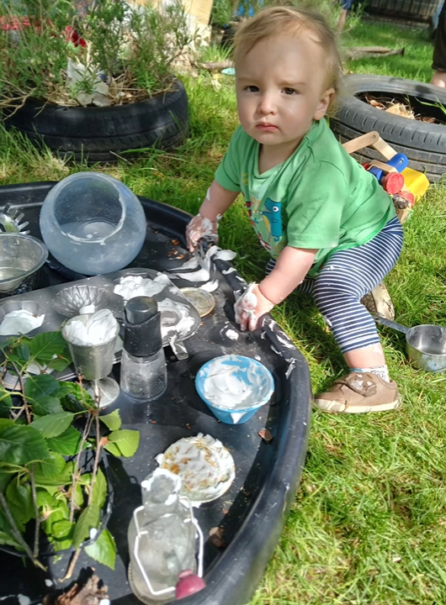
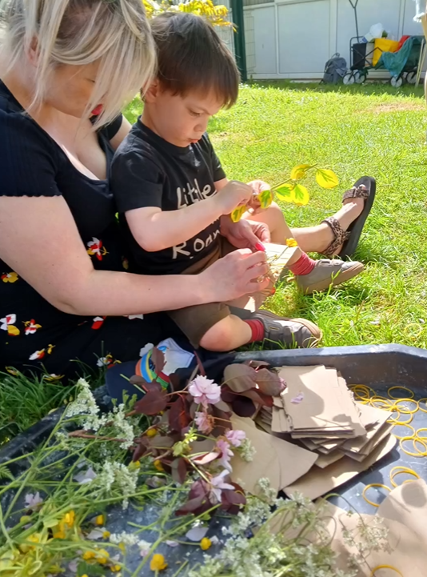
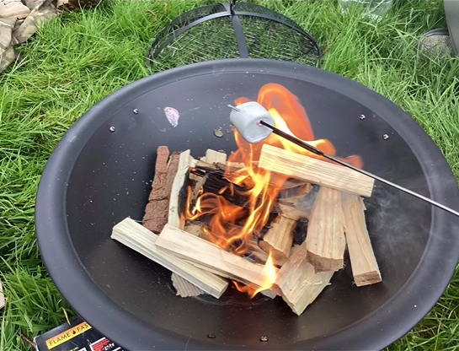
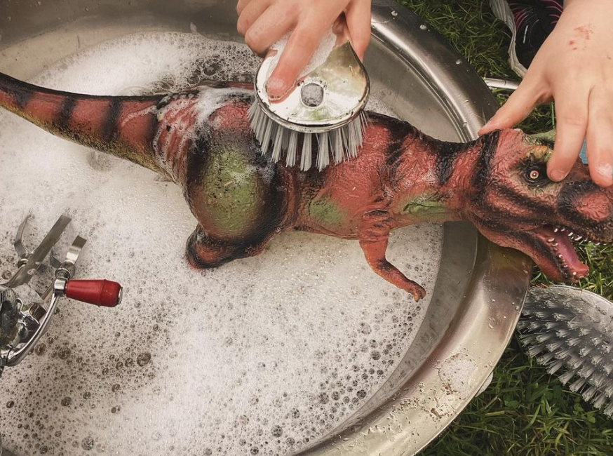
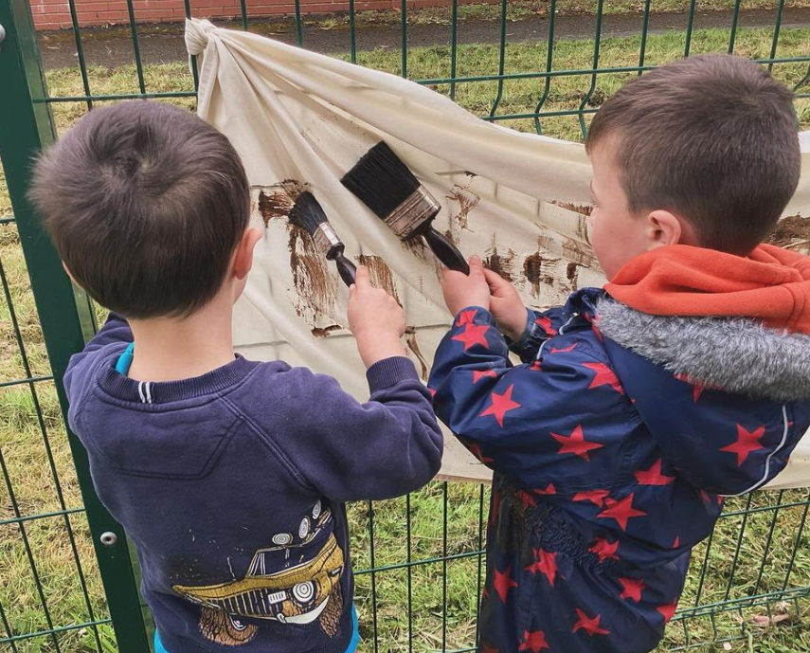
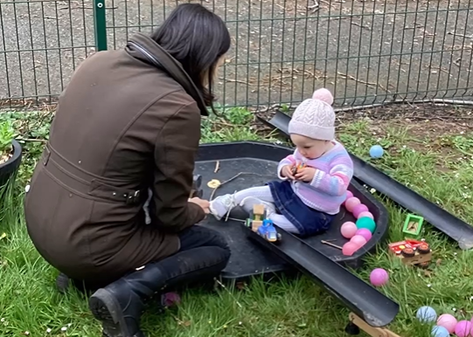
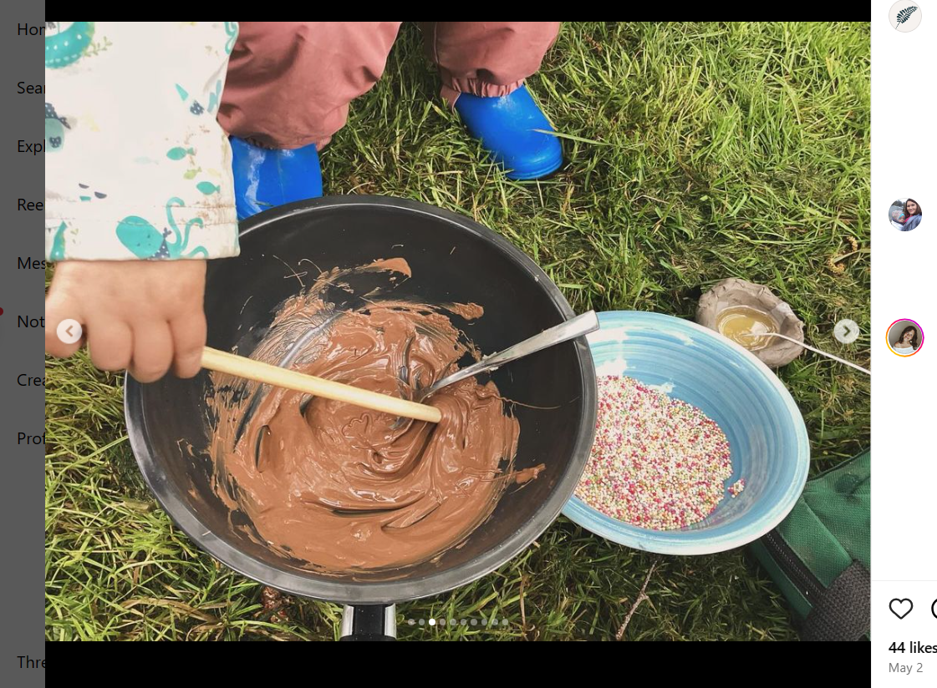
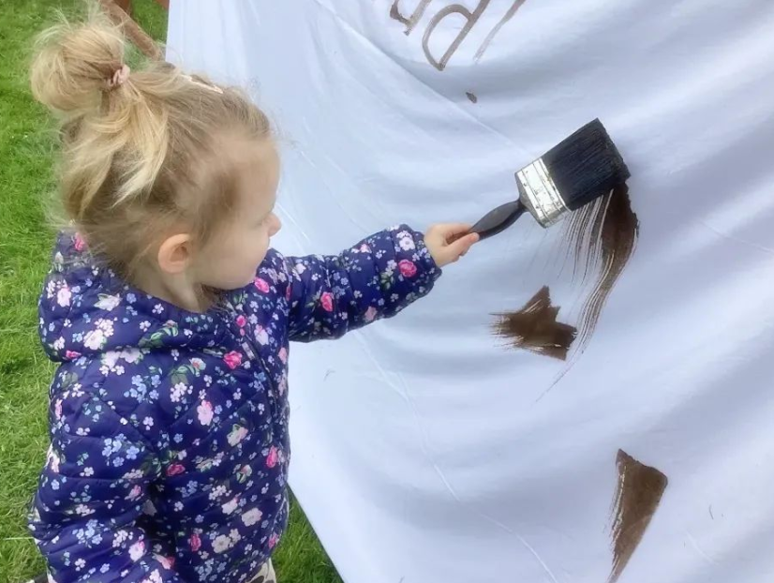
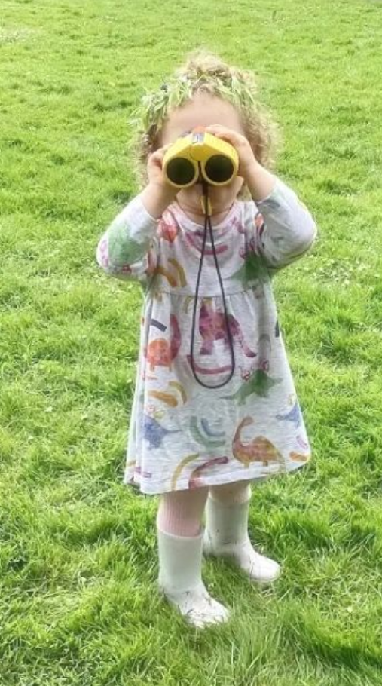
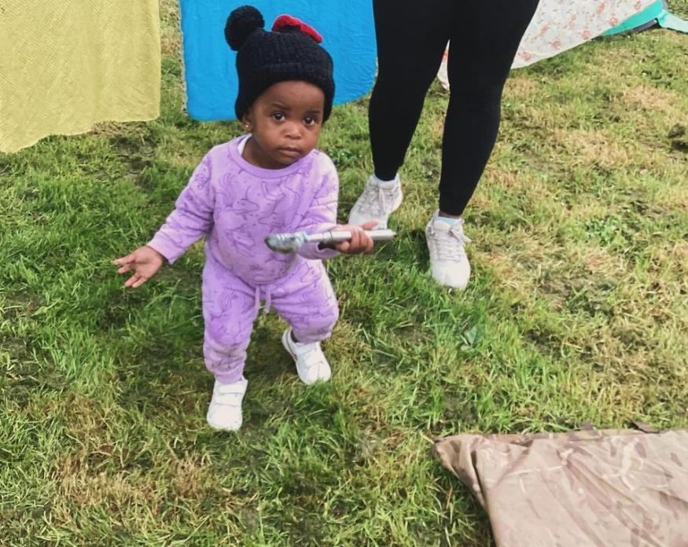
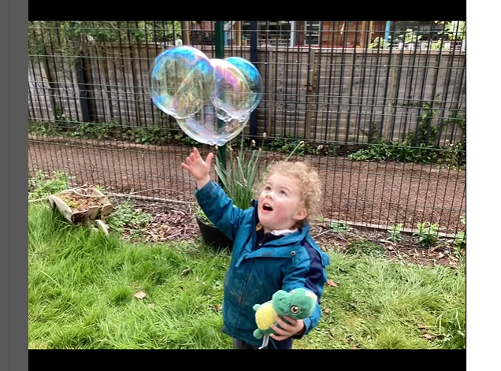

Slide 19
The aims of Herefordshire Nurture through Nature are to improve people's wellbeing through activities that enhance a connection to nature. There is a strong focus on supporting people who are vulnerable and marginalised.
The Herefordshire Together funding has gone to setting up two outdoor playgroups in South Wye and Leominster. Supporting families with children under 5, experiencing adverse childhood experiences.
The outdoor playgroups focus on cognitive, social, and emotional development. Activities such as cooking over a campfire and using tools enhance fine and gross motor skills, laying a foundation for future learning. Experiential learning will enable children to explore and interact with the natural environment.
Approx 20 families are attending each session, the parents attending have said that the sessions are beneficial for their wellbeing and an antidote to loneliness.

Slide 20
  Herefordshire Together
  Grant Winners
  Growing Local
24th March 2022

Slide 21
  Herefordshire Together
  Grant Winners
  Hope Support Services
24th March 2022

Slide 22

Herefordshire Together 2024
Louise Dockstader

Slide 23


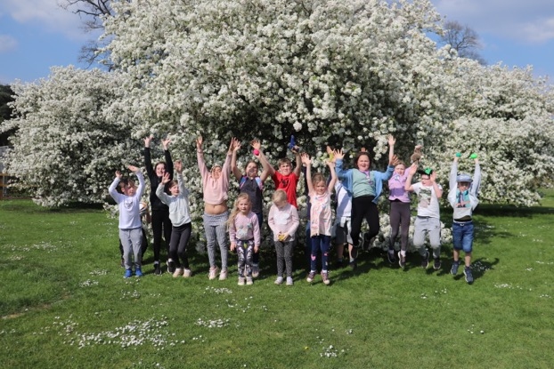
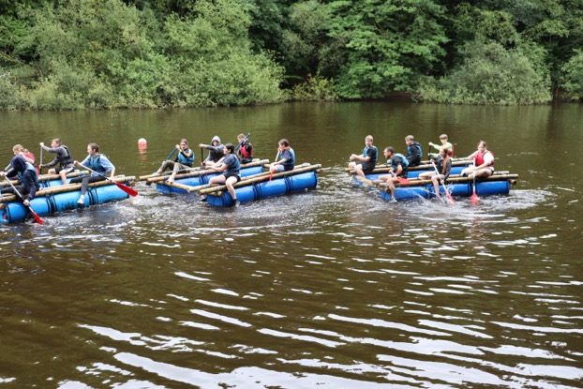
WHO WE ARE
We support children and young people age 5 to 25 when a loved one is diagnosed with a serious or terminal illness, for as long as is needed, through and beyond bereavement.
A traumatic experience such as a serious family health crisis or bereavement does not HAVE to result in an Adverse Childhood Experience. The children referred to us are, in general, struggling at that point. We work to get them back on track.

Slide 24
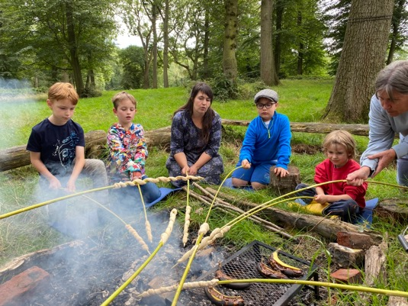
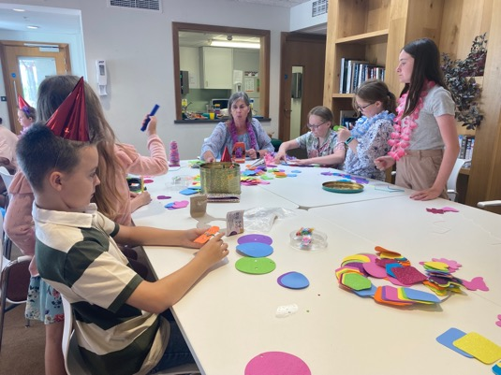
WHAT WE DO
In-person services to about 500 children UK-wide of which about 200-250 children and young people, and their families, are in Herefordshire.
1-to-1 face-to-face support sessions onsite in 22% of Herefordshire schools, but also at home or in safe spaces in the community.
Youth groups around the county, plus residential trips and activities.
Regular group sessions at St Michael's Hospice in Hereford.
Youth management teams: the Y-Team in Herefordshire, A-Team online.

Slide 25
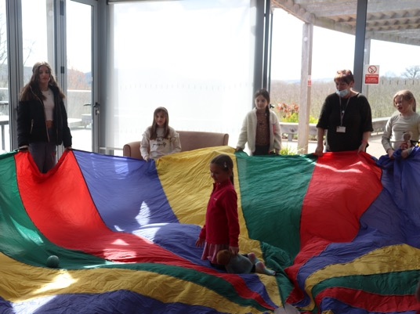
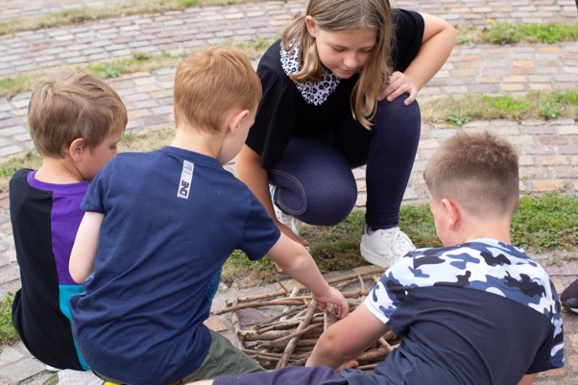
WHAT WE DO
It’s all about connection!

Slide 26
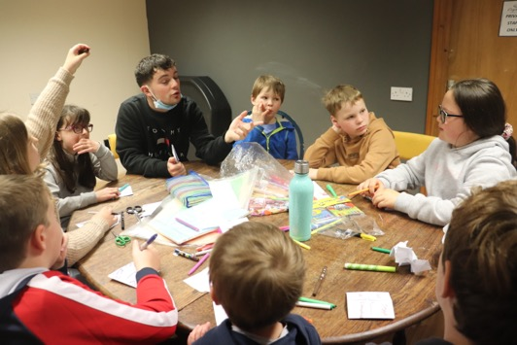
OUR PROJECT
FUND GOALS:
Create lasting and meaningful connections for people to improve their emotional wellbeing and sense of community belonging
RESPONSE:
New youth group in Ross-on-Wye for peer-to-peer support
Join with all other groups in activity sessions 1x/mo
Recruit and manage volunteers, volunteer appreciation event

Slide 27
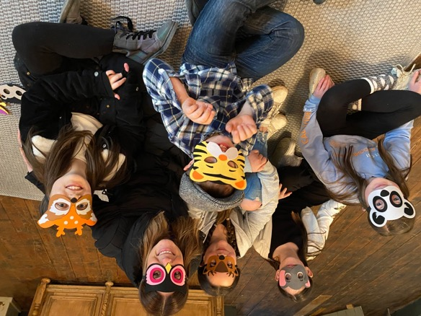
OUR PROJECT
FUND GOALS:
Strengthen the reach to families in need
RESPONSE:
2 new Family Days for families to make lasting connections for peer-to-peer support

Slide 28
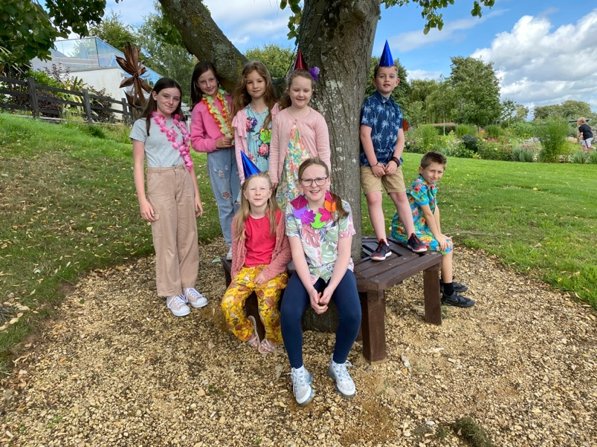
IMPLEMENTATION
One part-time community support worker (15 hrs/wk)

Slide 29
THANK YOU!

Slide 30
  Herefordshire Together
  Grant Winners
  Home-Start Herefordshire
24th March 2022

Slide 31

https://youtu.be/Ans4t7TDK98

Slide 32
  Herefordshire Together
  Grant Winners
  Hereford Community Farm
24th March 2022

Slide 33




Herefordshire Together Fund
Roots of Connection
We believe that effective and workable solutions for positive change lie within the people and communities in which they live and that Together We Are Stronger.
The unique approach of Roots of Connection incorporates a community led Green Care Model utilising the non-threatening appeal of animals & the natural environment to engage, inform, empower and give a sense of belonging.
Pro-actively engaging through activities and events we will facilitate connectivity through identifying ‘Community Acorns’
the established and trusted points of contact to seek seldom heard voices to:
Identify issues in common
Develop a network of accessible, lasting community-based support
Provide equity of opportunity through wraparound support
www.herefordcommunityfarm.co.uk. herefordcommunityfarm@gmail.com

Slide 35
  Herefordshire Together
  Grant Winners
  WMRSASC
24th March 2022

Slide 36
Supporting survivors of sexual violence

Slide 37
WMRSASC Services Overview
Advocacy (5+)
Counselling (11+)
ISVA, CHISVA, FISVA & other specialisms
Early Intervention & Prevention Service (5+)
Education in schools &
1-1 intervention
HSB assessment & intervention
Training
For survivors and family members that are supporting survivors

Slide 38
Further Support & Information
01905 611655
referrals@wmrsasc.org.uk
https://www.wmrsasc.org.uk

Slide 39
  Herefordshire Together
  Grant Winners
  Connexus Homes Ltd
24th March 2022

Slide 40
  Herefordshire Together
  Grant Winners
  Ewyas Harold Craft Centre
24th March 2022

Slide 41

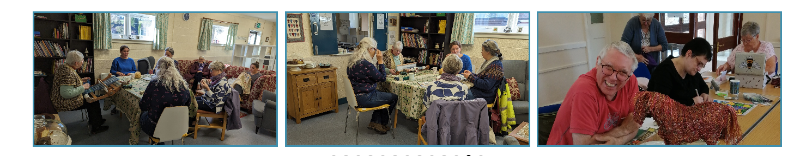
The Arts and Crafts Community Centre’s aims to provide a wide range of arts and crafts opportunities for the local community to experience, to provide a social space for the community, to provide an exhibition space and business outlet for artists and creative people in the community and the wider Herefordshire area. To enable the widest community to be able to see art and creative work and to participate in it. To offer courses and learning opportunities. To offer selling opportunities for local producers of arts and crafts. The Herefordshire Together grant will enable the centre to train and enable volunteers in basic food hygiene to purchase equipment so parents with babies and small children to use the site, eg wall mounted baby changing facilities and highchair. To purchase craft equipment, thus widening the workshops and courses it can offer. It will also enable the centre users to be able to access that equipment to use to further their skills after the courses are complete. The remainder will be used to purchase a sewing machine, waterproof aprons, a set of silver/metal working basic kits.
Case study
A local lady living with poor mobility and feeling isolated, impacting her mental health. Now engaging with the group and getting out more. She has attended some courses as well as one of the weekly groups, taken on new skills and is now using the centre on a regular basis. Now producing crafts to order!

Slide 42
  Herefordshire Together
  Grant Winners
  Ross-on-Wye Community Development Trust
24th March 2022

Slide 43


Making connections
Ali Park - Project Officer
April 2024

Slide 44







SMALL GROUP OF PEOPLE INTERESTED IN COMMUNITY HEALTH AND WELL-BEING
AROSE FROM TOWN COUNCIL MENTAL HEALTH AND WELLBEING GROUP
WANTED TO TRANSFER TO ROSS SOME IDEAS THAT HAVE WORKED ELSEWHERE
TOWN COUNCIL VOTED TO SUPPORT A NEW CDT IN JUNE 2018
ROSS COMMUNITY DEVELOPMENT TRUST EST. 2019 AS A CHARITY (CIO)
And several others ………..
FIRST PROJECT - ROSS GOOD NEIGHBOURS
WARM ROSS
CLOVER

Slide 45
Original vision - connectedness
Community
Volunteers

Slide 46
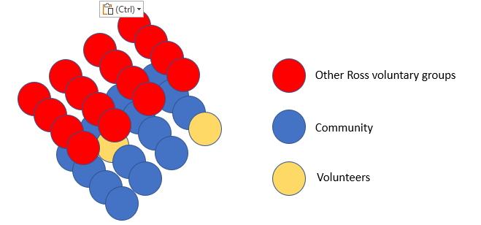
Networking the VCS to the community

Slide 47
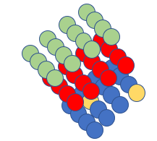
Connecting to other services
Statutory services
Other Ross groups
Community
Volunteers

Slide 48
How do we make connections?
Everyone
People who are online
Face-to-face connections volunteer/client
Ross Neighbourhood News, delivered quarterly to 6300 letterboxes
24/7 Helpline, staffed by volunteers working from home M-F
Website and email
Facebook
  Facebook Live events
  Sharing of other groups’ FB posts

Slide 49
What’s transferable elsewhere?
Key question: is a model developed for a market town of 11k+ transferable to smaller communities?
Probably not, as a whole model
But the communication infrastructure could maybe be shared with other groups
Novel elements are Helpline combined with paper through letterboxes

Slide 50
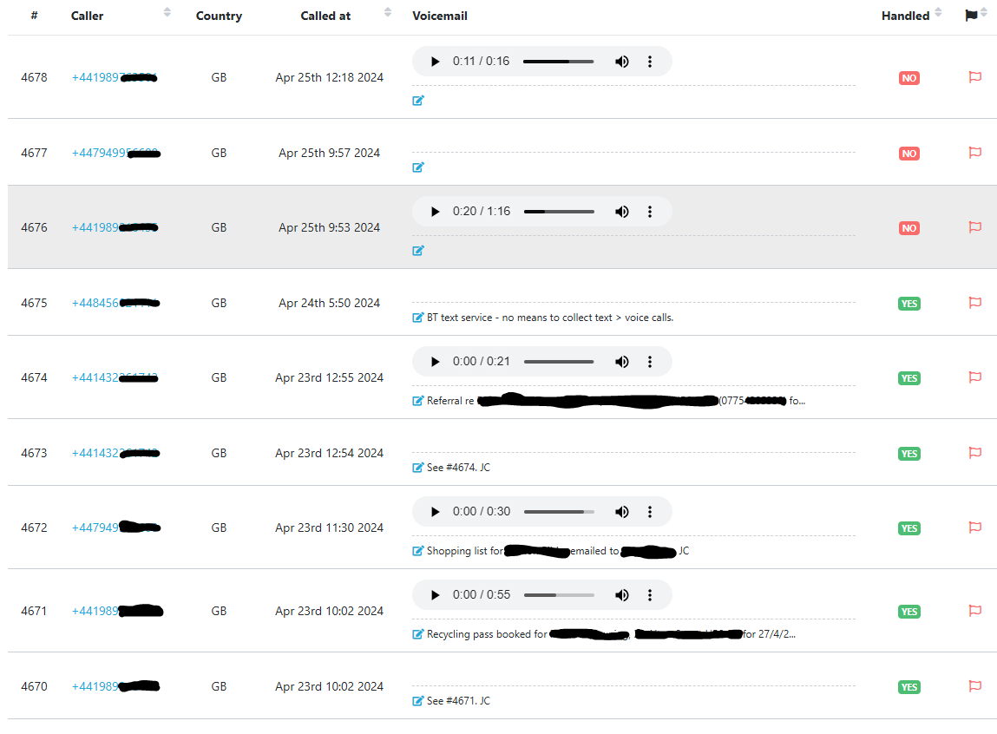
Helpline interface

Slide 51
How could this work?
Ross CDT offers to share access to the Helpline with other groups
Possibility of a local number for those outside the 01989 area
Groups wanting to use our Helpline could provide one or two volunteers for the rota
All Helpline volunteers trained to respond to calls in respect of each locality that is in the scheme
Local publicity for the Helpline and the services it is used to access using both letter box and digital distribution methods

Slide 52
Opportunities and challenges
Opportunities
More Helpline volunteers provides resilience and possible re-instatement of Sat/Sun call backs
Challenges
Supporting volunteers to deal with a more complex system
Keeping area information up to date on the Helpline database
Maintaining regular letterbox deliveries in rural areas

Slide 53
  Herefordshire Together
  Grant Winners
  @The Hub CIC
24th March 2022

Slide 54
  Herefordshire Together
  Grant Winners
  Open Arms Kington (OAK)
24th March 2022

Slide 55
  Herefordshire Together
  Grant Winners
  Age UK Worcester, Malvern Hills & Hereford Localities
24th March 2022

Slide 56

  Richard Weaver
  Citizens UK
  Community Organising & Citizens Herefordshire
24th March 2022

Slide 57

Vision: ‘A healthy democracy with civil society at its heart’
Mission: ‘To build the capacity of people to participate in public life, to act together for the common good, to win change, and to strengthen civic institutions in the process’

Slide 58
We build the power of communities to make change on the issues they want to change
We build alliances of key civil society organisations in a geographical area
Faith, Education, Union, and Community Organisations

Slide 59


Slide 60
These alliances practice the craft of Community Organising by:
1. identifying and developing leaders;
2. running sophisticated, winnable campaigns; and
3. strengthening organisations to make an impact in their community/sector

Slide 61
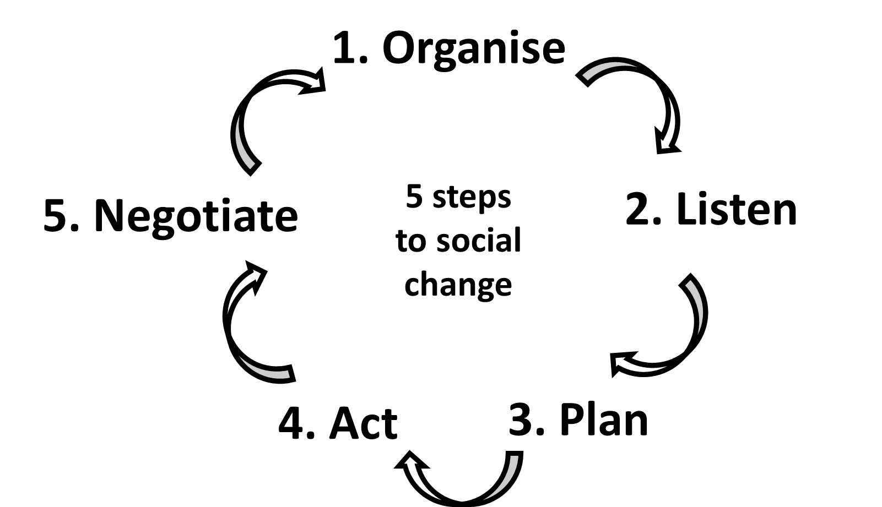

Slide 62
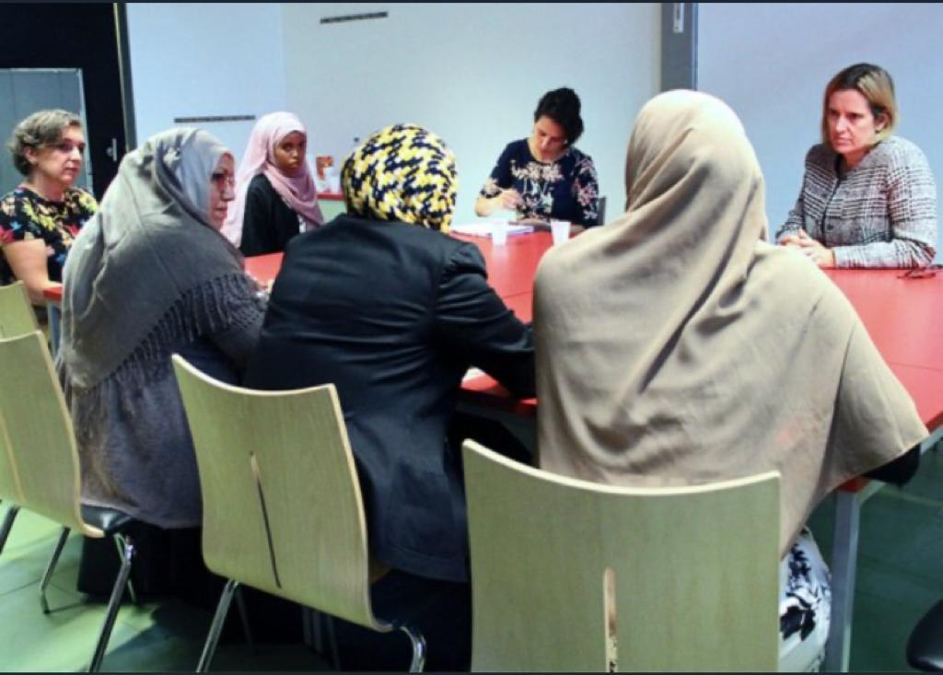
‘If you don’t have a seat at the table, you’re probably
on the menu’

Slide 63
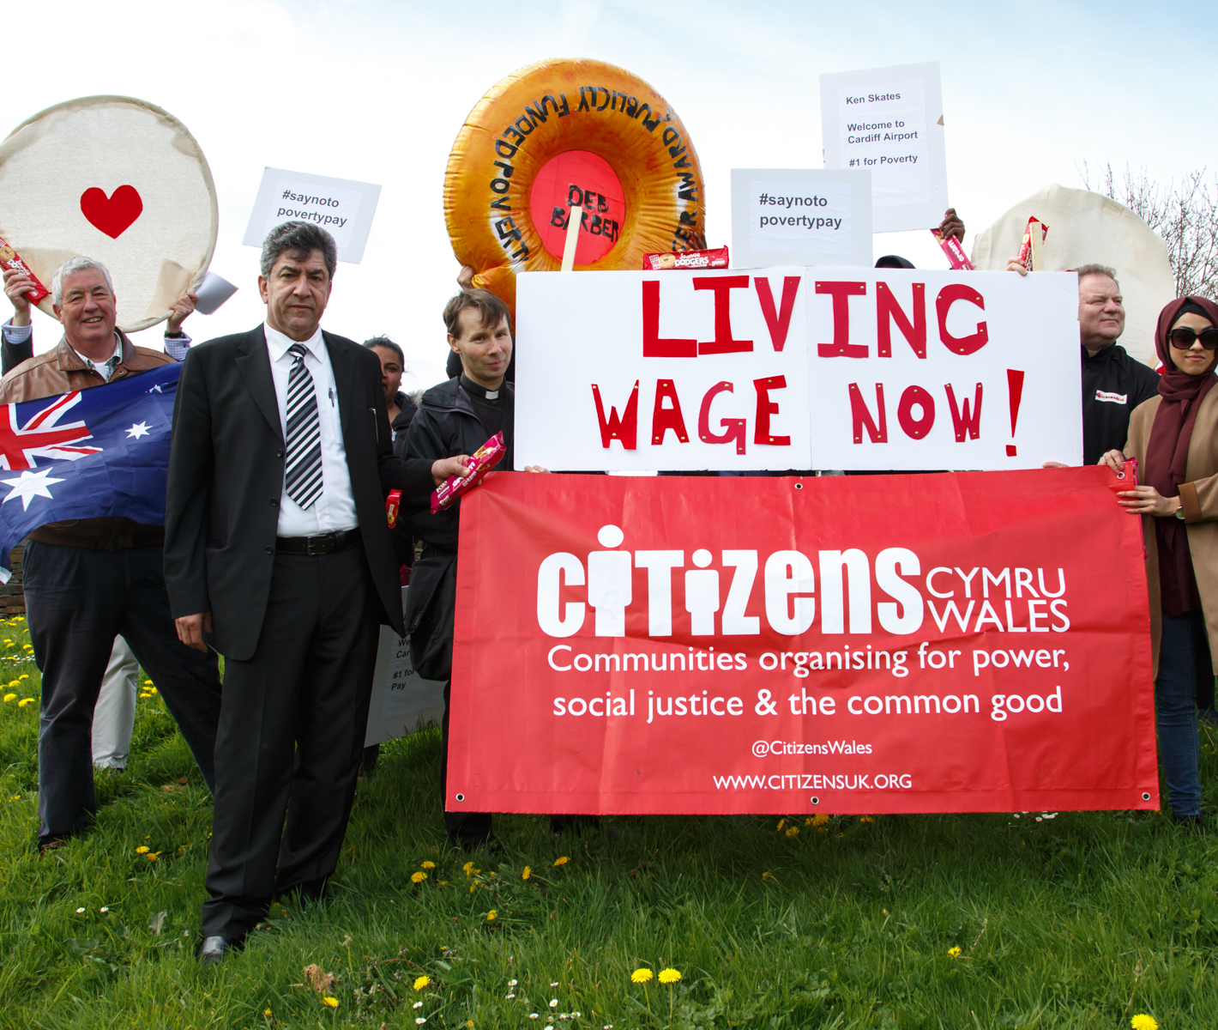
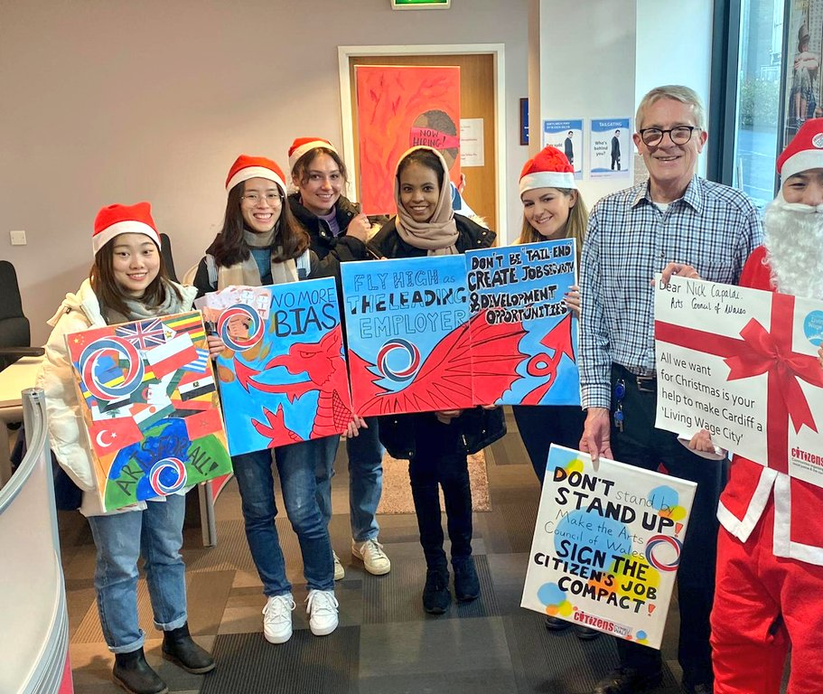
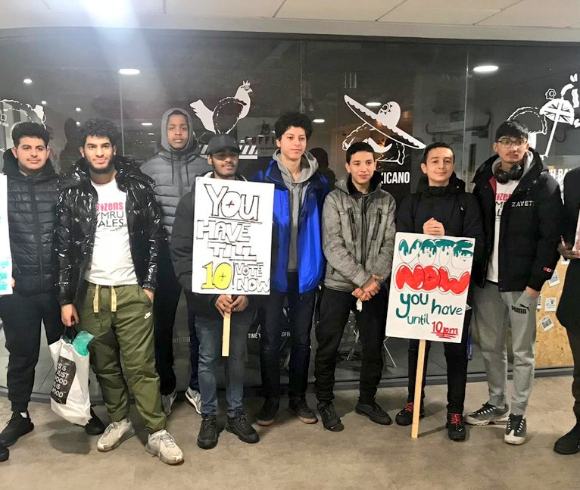
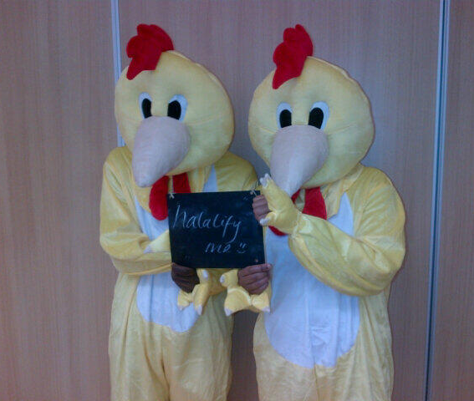
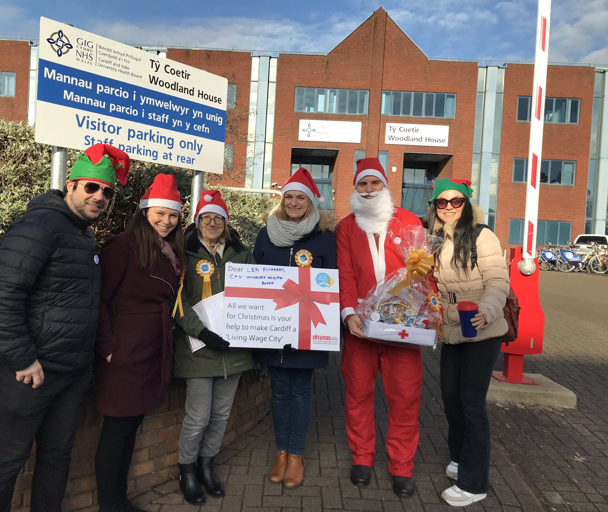
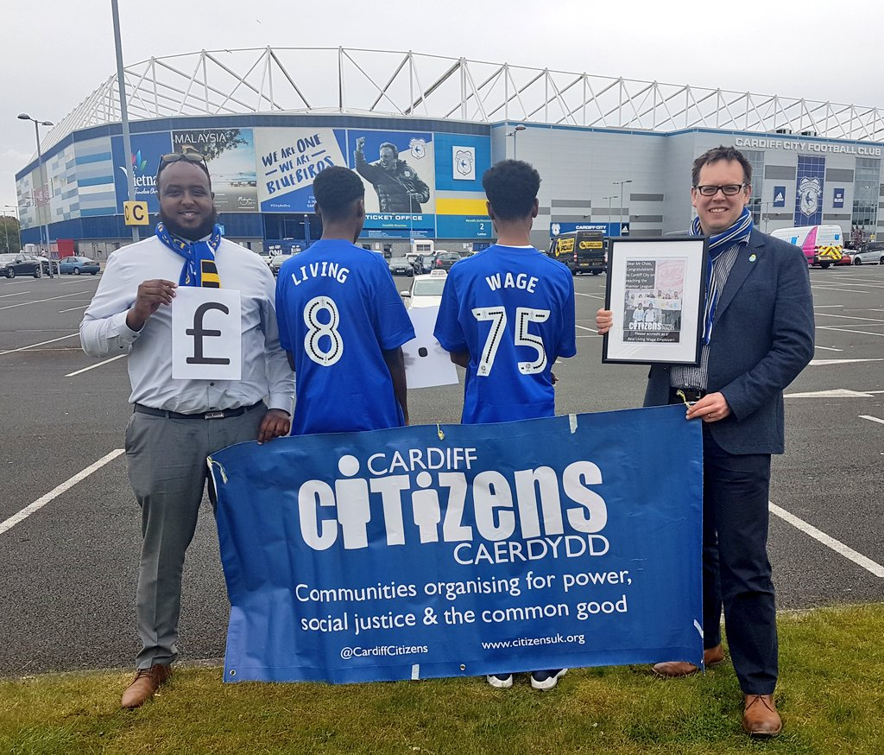

Slide 64
If you could change one thing that would make Herefordshire a better place for everyone, what would it be, and why?

Slide 65

  Paddy Nugent
  Friends of Castle Green
  Listening at a local level
24th March 2022

Slide 66

24th March 2022
  Mini Community Organising Exercise

Slide 67
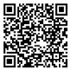
Networking & Light Lunch
Join us at the next Community Partnership Event on Wednesday 17th July at the Kindle Centre.
Community Partnership enquiries to:
sam@healthwatchherefordshire.co.uk
24th March 2022

