Slide 1

17th July 2024
9:00-9:30 Arrival & networking
9:30-9:35 Introduction & updates
9:35-10:00 Introduction to Work Well and VCSE involvement
10:00-10:20 Highlights from the State of the Sector Survey 2024
10:20-10:50 Infrastructure support
10:50-11:05 BREAK
11:05-12:00 Infrastructure support in Herefordshire
12:00-12:30 Feedback
24th March 2022

Slide 2

  Christine Price
  Chief Officer
  Healthwatch Herefordshire
  Introduction & Updates
24th March 2022

Slide 3
  Introduction to Work Well and VCSE involvement
  Christine Price
  Healthwatch Herefordshire
24th March 2022

Slide 4

WorkWell
Herefordshire Community Partnership
17th July 2024

Slide 5




What is WorkWell?
Department for Work and Pensions (DWP) funded scheme to help people:
Start, Stay and Succeed in work
Start: People not working because of a disability or health condition that could be overcome with some reasonable adjustments.
Stay: People in employment but struggling to hold down their job because of their disability or health condition.
Succeed: The programme aims to help people through coaching and other support mechanisms to overcome these barriers and succeed in the workplace.

Slide 6
Scope of the local scheme
Target is to support 2,360 people between 01 October 2024 and 31st March 2026
Accessible to anybody in Herefordshire and Worcestershire who:
  Has an address in the area, or is registered with a GP in H&W
  and
  Has an entitlement to work
Could be employed in large, medium or small enterprises
Could be employed in the public sector
Could be employed in the VCSE
Could be self employed
Could be not working in receipt of benefits
Could be not working and not currently receiving any support

Slide 7
Access to the service
Access to the service could be one of the following:
Following request for “sick/fit note” from GP (GP referral)
Referral by employer (with person’s consent)
Self-referral / family / friend / community organisation
Referral from Job Centre Plus or Council Benefits service (with the person’s consent)
Health conditions expected to be covered:
Mental health
Musco-skeletal (conditions that may be helped with Physiotherapy or guided exercise)
Other conditions that may require non-medical or low-level medical interventions or where the individual may benefit from general counselling or coaching
It is not an alternative route into NHS services for health conditions that don’t affect a person’s employment

Slide 8
Typical expected participant journey
Access
Assessment
Support
Exit
GP Referral
Assessment by
Work and Health Coach (WHC)
based in
Primary Care Network (PCN)
Agreement to
Implement a personal plan
Ongoing coaching and support from WHC
Exit from the programme, either following success completion or agreement between WHC and Individual to cease support if it is not having impact.
Referral to Multi-Disciplinary Team (MDT)
Other referral
Employer
Self
JC+ etc
Triage to assess suitability
Referral to External Partner or Supplier
PCN based services
External partners / stakeholders

Slide 9


The role for VCSE Partners
Referral to the service
Service Provision
Do you support people who might benefit from the service?
…… then please refer them on.
Details of how to do this will be shared in due course.
Could you support somebody that might need some additional support to help them succeed in the workplace?
…… then please make your organisation known to the Workwell Team.
We will be commissioning external suppliers to support delivery from September

Slide 10
For more information
We are in the early stages of developing the service so there is not currently any promotional material, however……..
For more information about Workwell please contact
david.mehaffey@nhs.net
To register your interest in providing services to Workwell, please email
Caroline.vertigen1@nhs.net

Slide 11

  Highlights from the State of the Sector Survey 2024
  Impact Consultancy
24th March 2022

Slide 12

  Infrastructure support
  Hannah McSherry, Senior Commissioning Officer, Community Wellbeing, Herefordshire Council
24th March 2022

Slide 13
Infrastructure Support Presentation
Hannah McSherry
15.07.24

Slide 14
What is infrastructure support?
The National Association for Voluntary and Community Action (Navca) are a national membership body for infrastructure organisations supporting the VCS in England. They describe infrastructure support as the following four functions:
Leadership and advocacy
Partnership and collaborations
Capacity Building
Volunteering

Slide 15
Kings Fund - Actions to Support Partnership Report
Published in April 2023, this report indicates that there are three main barriers and challenges that impact on partnership working with the VCSE sector:
Commissioning, service design and delivery
Sharing data, intelligence and insight
Funding and sustainable investment
The report identifies a number of actions that the Integrated Care Systems and Local Authorities can take to engage with the sector to address these barriers including early planning and decision making, building an understanding of the sector and approaches to co-deign and co-production.

Slide 16
Current commissioned service
HVOSS are currently commissioned by HC to deliver the following:
Act as a point of contact and umbrella organisation and strategic voice on behalf of the sector.
Develop the capacity of the voluntary and community sector through infrastructure support, particularly in relation to strengthening and supporting volunteer activity.
Work with the community sector and local community leaders to develop and build a vibrant community offer that meets local need.
Maximise income and funding opportunities to support Talk Community priorities.
These activities are complimentary to the Talk Community offer.
The Council have set aside a budget for £47K for infrastructure services for 2024/25. This has been used to extend the existing contract with HVOSS until 31.12.24 whilst options around future delivery are explored.

Slide 17
SOS –What does the sector say that they need?
Most common support needs are:
Marketing and communications
Policies and procedures
Insurance and risk assessments
Time is the biggest barrier to accessing support.
Key gaps in support are:
Funding support
HR and legal support
General business development support
Help to recruit volunteers

Slide 18
Options for consideration – slide 1
Let the existing contract come to an end and encourage the sector to develop their own response without HC investment or influence.
Use UKSPF capacity building grant and new TC funding officer role as short term solution whilst longer term solutions are considered.
Develop a grant scheme for VCSE infrastructure support focusing on the four functions set out by NAVCA and feedback from SOS. This would mean that the sector could develop projects that respond directly to need enabling a more agile response to issues as they emerge. This could be a short or long term solution and would mean that a range of organisations could apply to offer specialist support services, but longer term funding is not guaranteed.

Slide 19
Options for consideration – slide 2
4. Offer VCSE support through a single contract as per the existing arrangements. The specification for this service would be based on the needs set out in the SOS.
5. Develop a VCSE commissioning framework enabling a range of organisations to offer specialist support services as and when funding becomes available. The suggestion around this is to develop a broad ‘health and wellbeing’ prevention focused framework that could used to commission not only VCSE support, but wider services as well.
6. Open to other ideas!

Slide 20
  Break for 15 mins and then…
  workshop time!
24th March 2022

Slide 21
Herefordshire Community Partnership - workshop
Aim
Understand the importance of infrastructure. Identify challenges and opportunities.
Discuss and feedback on the options for Herefordshire Council infrastructure support. Think about challenges, opportunities and your preference.
Don’t forget the art of the possible!

Slide 22

Four pillars of infrastructure
Notes:
Thriving Communities – our communities are our biggest asset. Over 2000 VCSE organisations
There will be a sense of belonging for people of all ages through meaningful connections where people know and trust each other, feel welcomed and represented, and are empowered to shape their local communities.
Opportunity for all
There will be a progressive and inclusive local economy that creates the right jobs for people and thus plays a key role in aiding greater social mobility and closing the inequalities gap
Healthy and Sustainable Places
Our neighbourhoods will be designed to create healthier and safer environments where there will be greater opportunities to be physically active and access healthy and affordable, locally produced food.
More people will live in good quality and affordable homes that are adequately heated and protected from environmental hazards such as flooding.
Healthy People
This will include utilising technology and digital solutions to support self-care

Slide 23

Four pillars of infrastructure
Challenges | Opportunities
The sector is increasingly working in isolation. | Co-location, sharing a common space can build personal relationships and facilitate different ways of working and shared learning.
Notes:
Thriving Communities – our communities are our biggest asset. Over 2000 VCSE organisations
There will be a sense of belonging for people of all ages through meaningful connections where people know and trust each other, feel welcomed and represented, and are empowered to shape their local communities.
Opportunity for all
There will be a progressive and inclusive local economy that creates the right jobs for people and thus plays a key role in aiding greater social mobility and closing the inequalities gap
Healthy and Sustainable Places
Our neighbourhoods will be designed to create healthier and safer environments where there will be greater opportunities to be physically active and access healthy and affordable, locally produced food.
More people will live in good quality and affordable homes that are adequately heated and protected from environmental hazards such as flooding.
Healthy People
This will include utilising technology and digital solutions to support self-care

Slide 24

Four pillars of infrastructure
Challenges | Opportunities
Recruiting and retaining volunteers. | One stop digital platform for all volunteering needs.
Challenges | Opportunities
The sector is increasingly working in isolation. | Co-location, sharing a common space can build personal relationships and facilitate different ways of working and shared learning.
Notes:
Thriving Communities – our communities are our biggest asset. Over 2000 VCSE organisations
There will be a sense of belonging for people of all ages through meaningful connections where people know and trust each other, feel welcomed and represented, and are empowered to shape their local communities.
Opportunity for all
There will be a progressive and inclusive local economy that creates the right jobs for people and thus plays a key role in aiding greater social mobility and closing the inequalities gap
Healthy and Sustainable Places
Our neighbourhoods will be designed to create healthier and safer environments where there will be greater opportunities to be physically active and access healthy and affordable, locally produced food.
More people will live in good quality and affordable homes that are adequately heated and protected from environmental hazards such as flooding.
Healthy People
This will include utilising technology and digital solutions to support self-care

Slide 25

Four pillars of infrastructure
Challenges | Opportunities
Gaps in funding, marketing and legal support. | Use the Community Chest for different teams, organisations, schools and businesses to bank their time and skills.
Challenges | Opportunities
The sector is increasingly working in isolation. | Co-location, sharing a common space can build personal relationships and facilitate different ways of working and shared learning.
Notes:
Thriving Communities – our communities are our biggest asset. Over 2000 VCSE organisations
There will be a sense of belonging for people of all ages through meaningful connections where people know and trust each other, feel welcomed and represented, and are empowered to shape their local communities.
Opportunity for all
There will be a progressive and inclusive local economy that creates the right jobs for people and thus plays a key role in aiding greater social mobility and closing the inequalities gap
Healthy and Sustainable Places
Our neighbourhoods will be designed to create healthier and safer environments where there will be greater opportunities to be physically active and access healthy and affordable, locally produced food.
More people will live in good quality and affordable homes that are adequately heated and protected from environmental hazards such as flooding.
Healthy People
This will include utilising technology and digital solutions to support self-care

Slide 26

Four pillars of infrastructure
Challenges | Opportunities
Lack of support for the VCSE sector to engage with commissioning and tendering processes. | Develop a VCSE commissioning framework enabling a range of organisations to offer specialist support services as and when funding becomes available.
Challenges | Opportunities
The sector is increasingly working in isolation. | Co-location, sharing a common space can build personal relationships and facilitate different ways of working and shared learning.
Notes:
Thriving Communities – our communities are our biggest asset. Over 2000 VCSE organisations
There will be a sense of belonging for people of all ages through meaningful connections where people know and trust each other, feel welcomed and represented, and are empowered to shape their local communities.
Opportunity for all
There will be a progressive and inclusive local economy that creates the right jobs for people and thus plays a key role in aiding greater social mobility and closing the inequalities gap
Healthy and Sustainable Places
Our neighbourhoods will be designed to create healthier and safer environments where there will be greater opportunities to be physically active and access healthy and affordable, locally produced food.
More people will live in good quality and affordable homes that are adequately heated and protected from environmental hazards such as flooding.
Healthy People
This will include utilising technology and digital solutions to support self-care

Slide 27
Options for infrastructure support
 | Options | Challenges | Opportunities | Preference
1 | Let the existing contract come to an end and encourage the sector to develop their own response without HC investment or influence.
2 | Use UKSPF capacity building grant and new TC funding officer role as short term solution whilst longer term solutions are considered.
3 | Develop a grant scheme for VCSE infrastructure support focusing on the four functions set out by NAVCA and feedback from SOS. This would mean that the sector could develop projects that respond directly to need enabling a more agile response to issues as they emerge. This could be a short- or long-term solution and would mean that a range of organisations could apply to offer specialist support services, but longer-term funding is not guaranteed.
4 | Offer VCSE support through a single contract as per the existing arrangements. The specification for this service would be based on the needs set out in the SOS.
5 | Develop a VCSE commissioning framework enabling a range of organisations to offer specialist support services as and when funding becomes available. The suggestion around this is to develop a broad ‘health and wellbeing’ prevention focused framework that could used to commission not only VCSE support, but wider services as well.
6 | Open to other ideas!
Notes:
Thriving Communities – our communities are our biggest asset. Over 2000 VCSE organisations
There will be a sense of belonging for people of all ages through meaningful connections where people know and trust each other, feel welcomed and represented, and are empowered to shape their local communities.
Opportunity for all
There will be a progressive and inclusive local economy that creates the right jobs for people and thus plays a key role in aiding greater social mobility and closing the inequalities gap
Healthy and Sustainable Places
Our neighbourhoods will be designed to create healthier and safer environments where there will be greater opportunities to be physically active and access healthy and affordable, locally produced food.
More people will live in good quality and affordable homes that are adequately heated and protected from environmental hazards such as flooding.
Healthy People
This will include utilising technology and digital solutions to support self-care

Slide 28
Herefordshire Community Partnership - workshop
Time to move!
Groups of 6, pick 2 of the 4 pillars.
Look at challenges and opportunities for the pillars you have chosen.
Discuss as a group the options for infrastructure support, looking at challenges, opportunities and what's your preference?

Slide 29
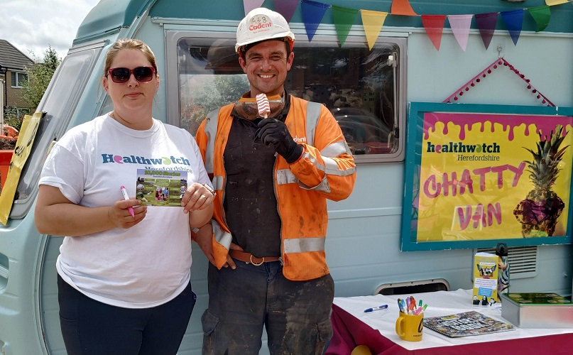
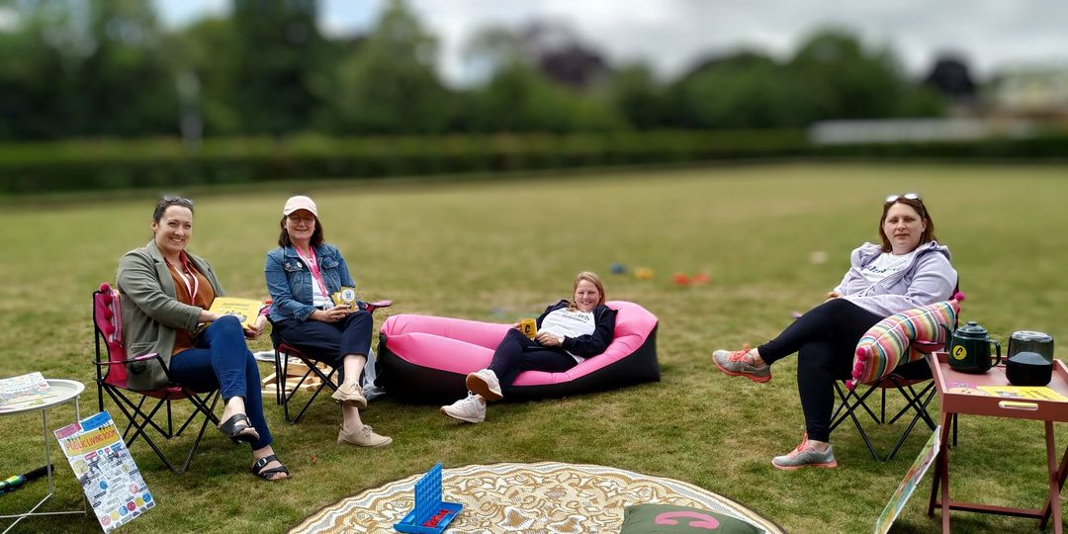
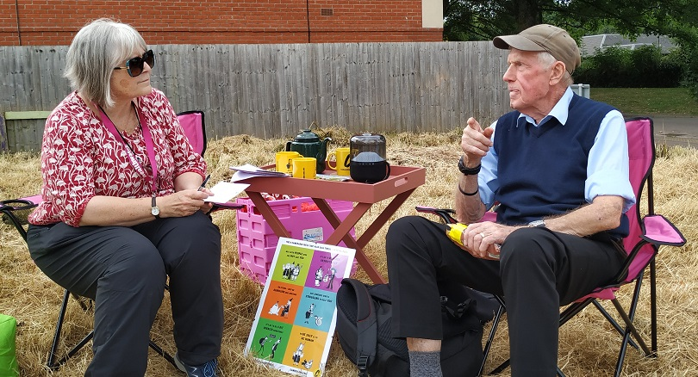
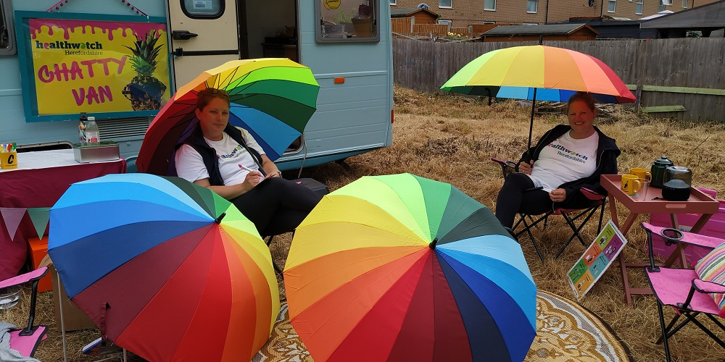

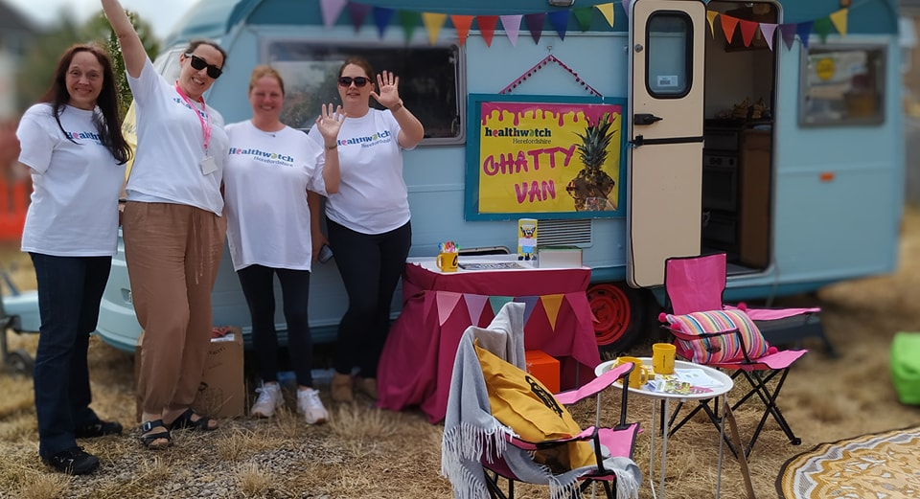
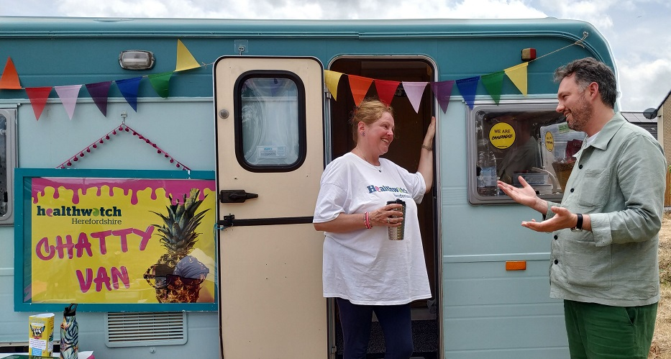
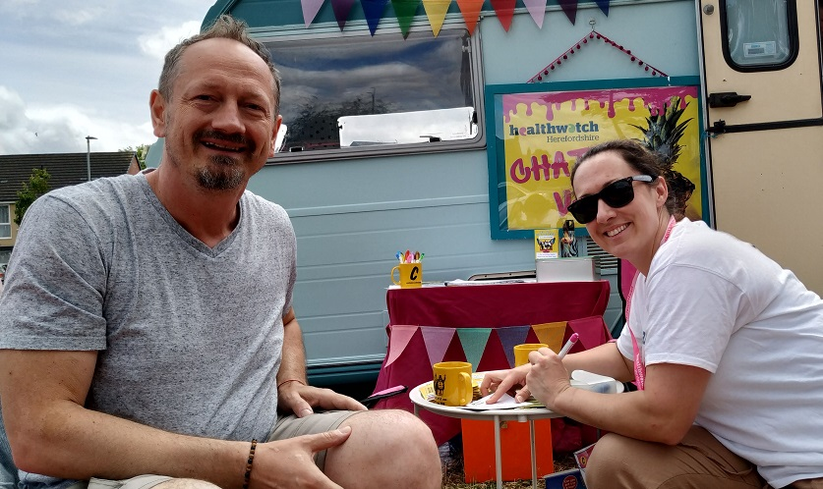
24th March 2022

Slide 30
Tell your stories!
We have officially launched 10,000 stories and we want you to be part of it, fill in a postcard or go online.
Are you having an event where we could come and set up the Chatty Van or Public Living Room?
24th March 2022

Slide 31

Networking & Light Lunch
Join us at the next immersive (Community Partnership) experience on Wednesday 18th September 2024 at The Kindle Centre!
Community Partnership enquiries to:
sam@healthwatchherefordshire.co.uk
simone@healthwatchherefordshire.co.uk
24th March 2022

